Slide 1



The Formation & Survival of Stellar Clusters from Hierarchical Sub-Structures
Michael Fellhauer
Theory & Star Formation Group
Departamento de Astronomía, Universidad de Concepción, Chile

Slide 2
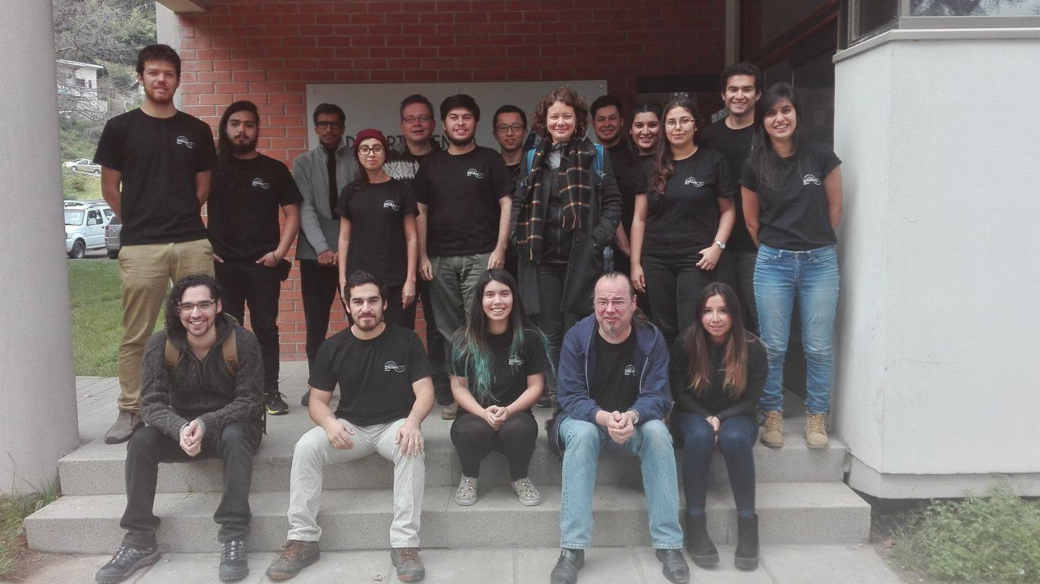
The Theory & Star Formation Group
in Concepcion

Slide 3
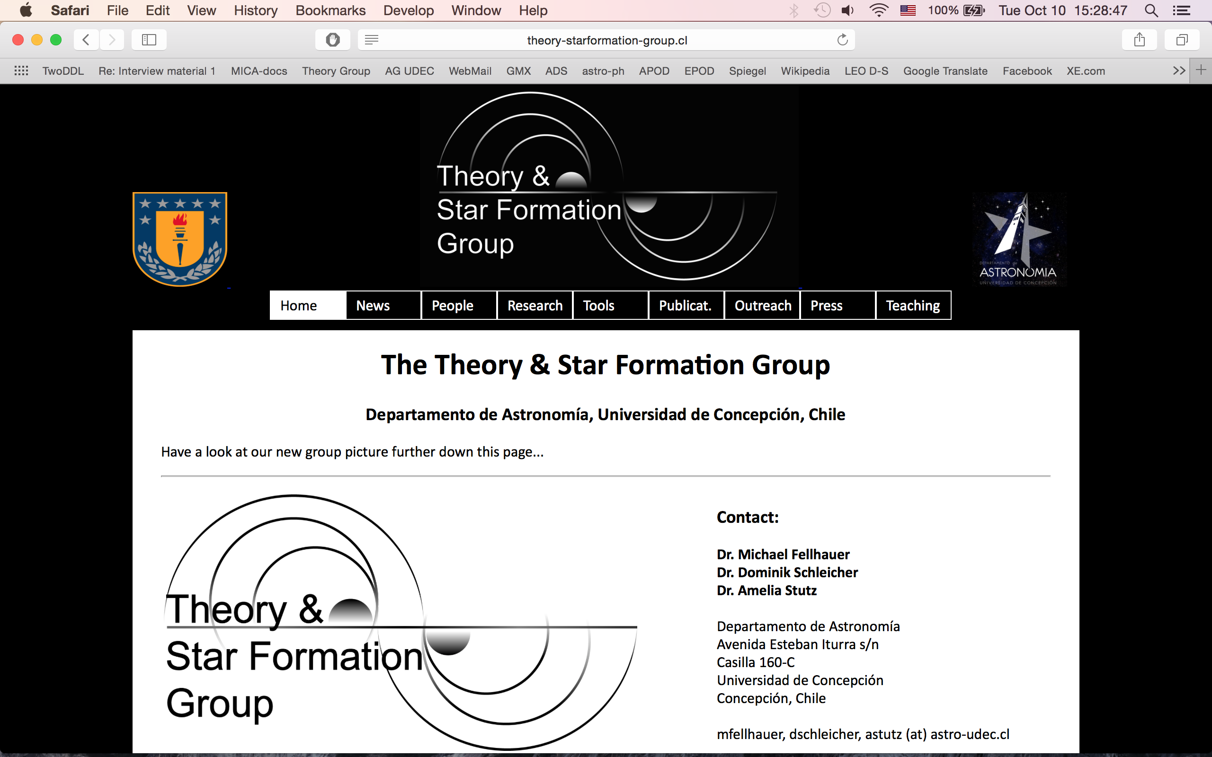
http://theory-starformation-group.cl/

Slide 4


How it all begun…
With a visit of Simon Goodwin from Sheffield to Concepcion
We had the idea to extend the hierarchical merger models to young embedded star clusters

Slide 5
But using very simple models as we cannot compete with the groups using super computers.
Instead we will focus on simulating the dynamics with high precision.
And we can perform hundreds of fast simulations allowing for statistical analysis of the results.

Slide 6




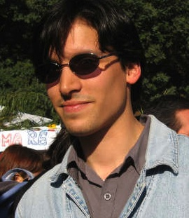


Involved in this project:
Dr. Michael Fellhauer
Dr. Simon Goodwin,
Sheffield UK
Dr. Rory Smith,
(now Seoul)
and: Roy Slater, Juan Pablo Farias (now Goeteborg), Matias Blaña (now Munich),
Raul Domiguez (soon Heidelberg), Ignacio Sotomayor (now working in the project)

Slide 7
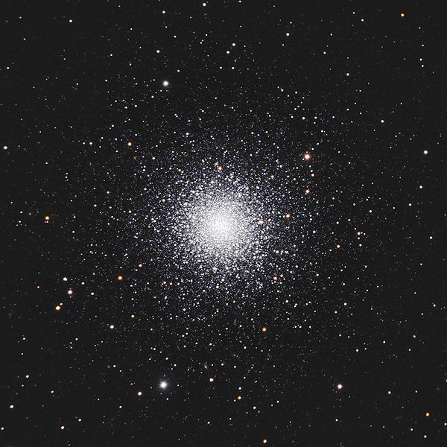
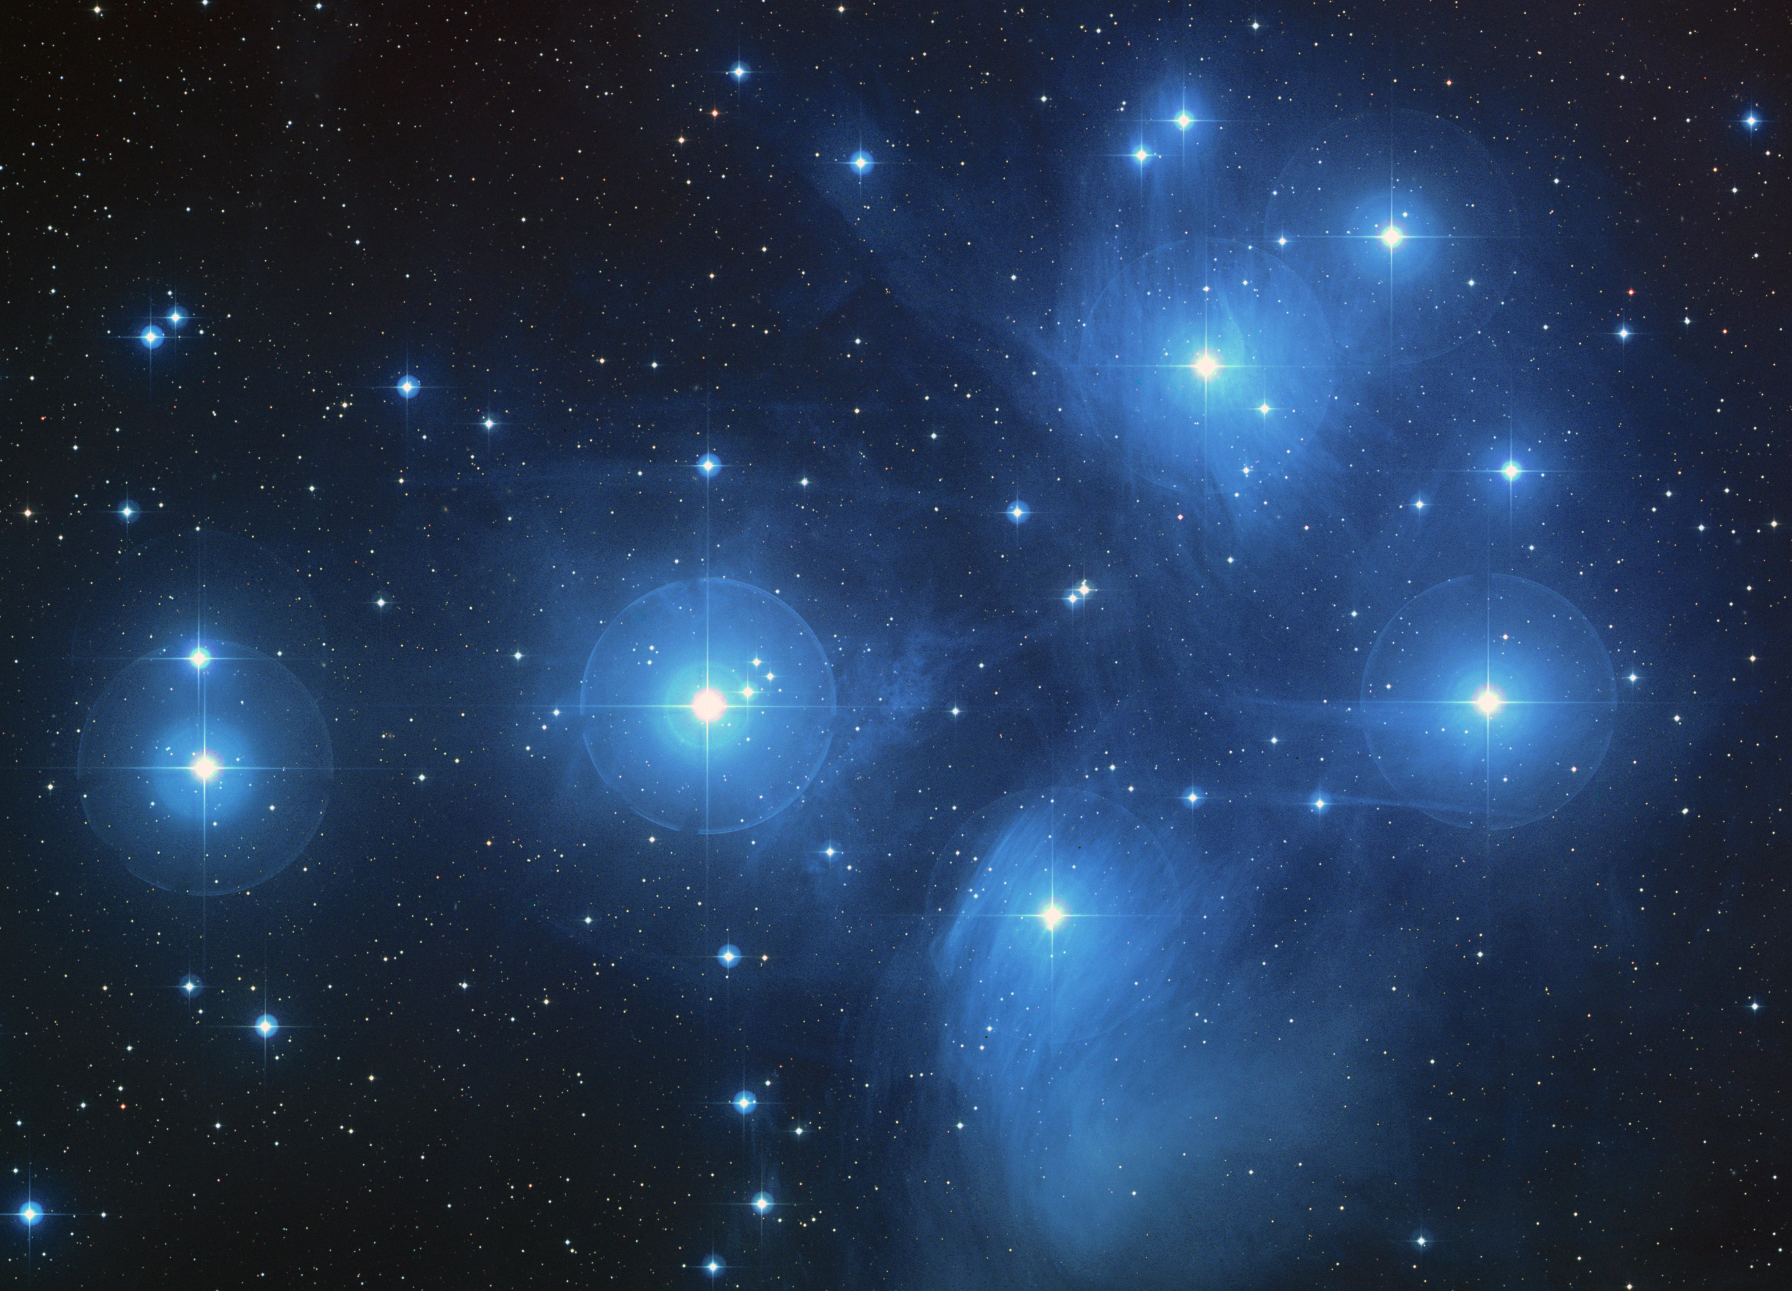
Stars are formed - in star clusters!
We know that stars do not form in isolation or evenly distributed.
They are formed in clusters, associations and groups.

Slide 8
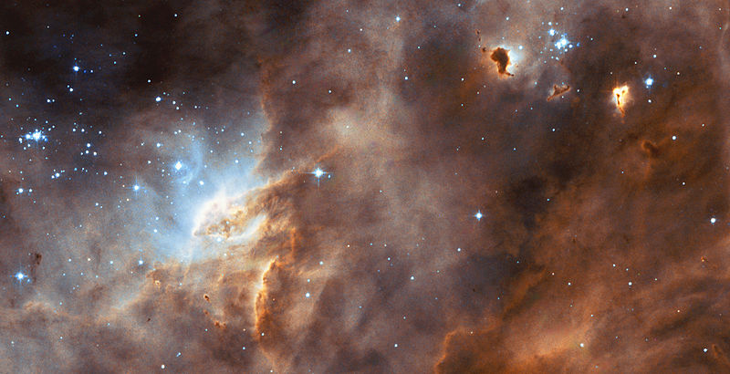
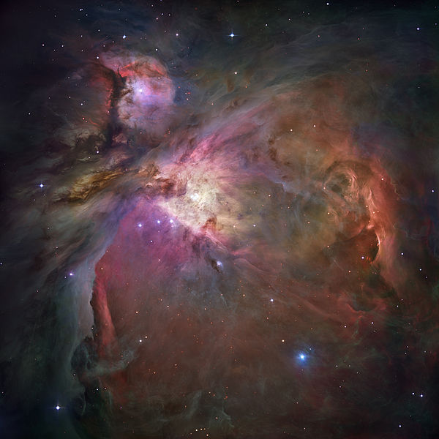
Star formation occurs through the collapse and fragmentation of unstable regions within cold molecular clouds.

Slide 9
A cold region (T ~ 10 K) in a molecular cloud does not have enough pressure generated by its temperature to withstand gravity.
The gas in this region collapses.
This collapse is not uniform, but leads to fragmentation into groups, which collapse further.
Within these groups we have more fragmentation into cores of star formation.
A core of star formation could house up to three proto-stars.

Slide 10

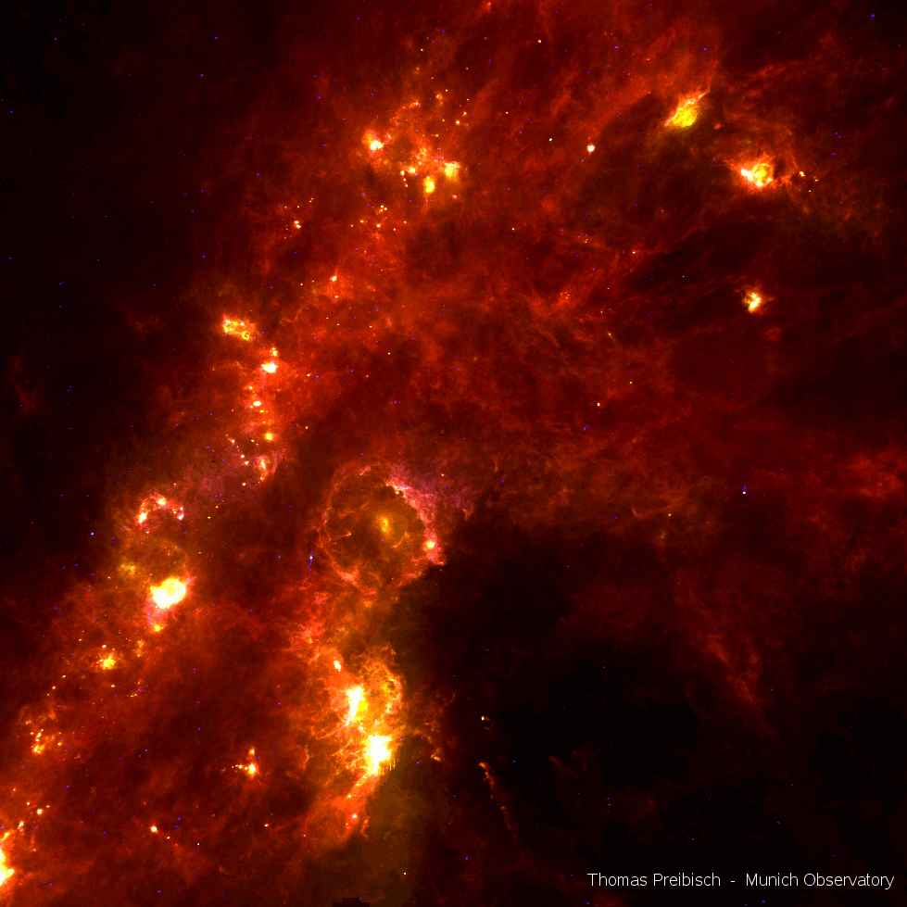
Perseus star forming region, stolen from Jennifer Hatchell, Exeter
Taurus, Perseus and Orion (IRAS)

Slide 11
If all stars form in clusters -
Why do we see stars in the field distributed uniformly and not just star clusters?
The star clusters dissolve and the stars spread out in the field due to internal processes and the gravitational force of the MW.
The main source of destruction is the phase of gas expulsion = "Infant Mortality”
How can star clusters survive infant mortality?

Slide 12
Gas is expelled by 'feedback'
Jets of proto-stars
The solar winds of stars of intermediate mass
Ultraviolet radiation of high mass stars
and finally
Explosion of super-novas

Slide 13

Classical image of
'Infant Mortality'

Slide 14
At first we have an embedded star cluster (stars inside the remaining gas).
This cluster is spherically symmetric and in virial equilibrium.
The ratio between the mass of the stars and the total mass is called star formation efficiency (SFE):

Slide 15
Classical Picture of formation & Survival:
Stars form a spherically symmetric distribution
Residual gas

Slide 16
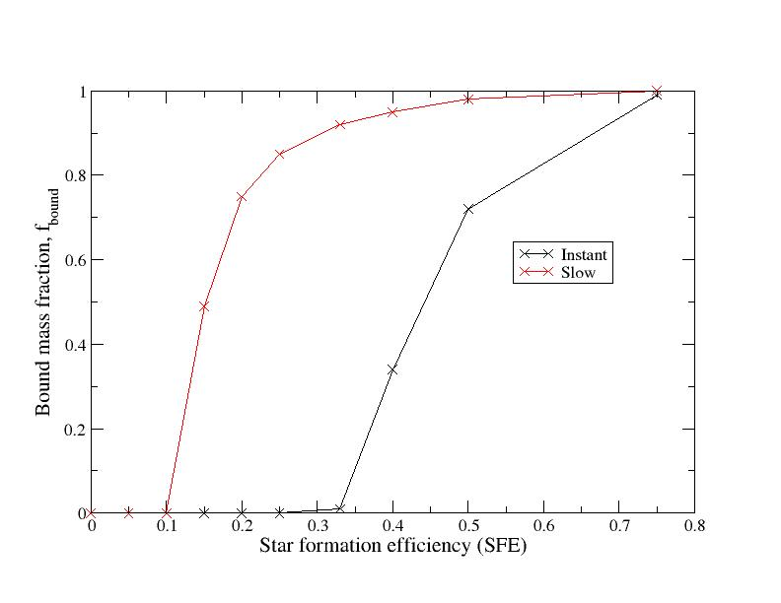
Survival of the star cluster is fully determined by the SFE
Baumgardt & Kroupa 2007

Slide 17
Efficiency of Star Formation has to be high (> 30%)
or
the expulsion of gas has to be slow for a cluster to survive
However, SFE in real embedded clusters is low - less than 10 percent.
So instead of:
Why are not all the stars in clusters? – The new question was:
Why do we see star clusters at all?

Slide 18
But if we expel the gas slowly enough, some clusters have the chance to survive.
Problem solved and we can go home –
or not?

Slide 19
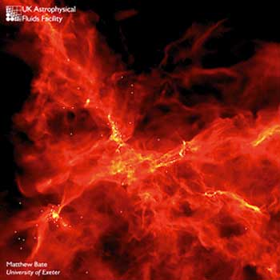
BUT:
“Clumpy” Star Formation
Stars form in small unevenly distributed sub-clumps and filaments containing a few to a few dozens of stars

Slide 20
Clumpy Star Formation
The stars are formed into small, unevenly distributed, sub-clumps and filaments, which contain some stars to a few tens of stars.
There is a growing observational and theoretical evidence that these stars can form sub-virial.

Slide 21
Virial Ratio Q
The virial parameter Q denotes the relationship between kinetic energy and potential energy
Q = 0: Object will perform a cold collapse (the stars do not have velocities)
Q < 0.5: stars do not have enough velocity - object will contract
Q = 0.5: object is in virial equilibrium
Q > 0.5: stars have too much velocity - object will expand
Q > = 1.0: the object is not bound and disperses

Slide 22
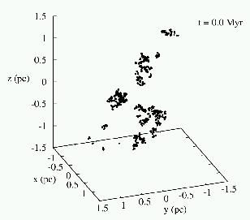
Our models:
Fractal initial conditions
(D_{frac} = 1.6) R_{max} = 1.5 pc
1000 equal mass ‘stars’
M* = 500 M_{sun}
analytic background gas (Plummer or homogen.)
M_{gas} = 2000 M_{sun}
➔ SFE = 0.2
Initial virial states:
Q_{ini} = 0.0…0.5
If you want to learn something – keep it simple!

Slide 23
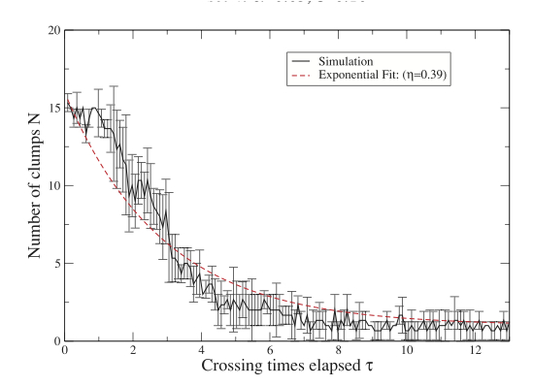
How fast is sub-structure erased?
Answer: Very fast!
Roy Slater
Smith, Slater et al. 2011b

Slide 24
Clumps are destroyed by:
internal two-body effects (low N per clump)
Heating by travelling through the central area
But not:
Merging (because velocities are too high, due to the background potential)
They form a central relatively smooth object (proto-cluster)

Slide 25
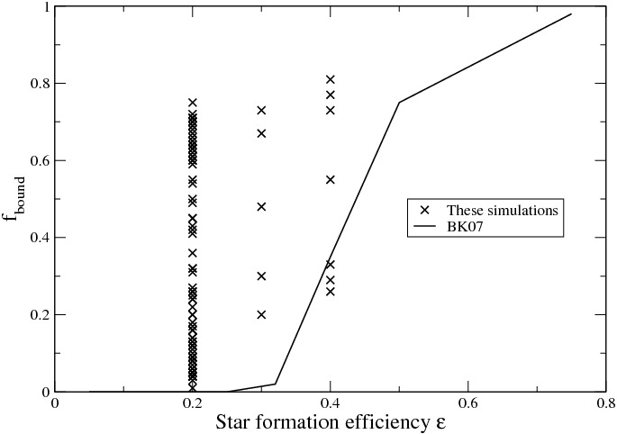
Which parameter describes the survival best?
SFE does not predict the results of our simulations

Slide 26
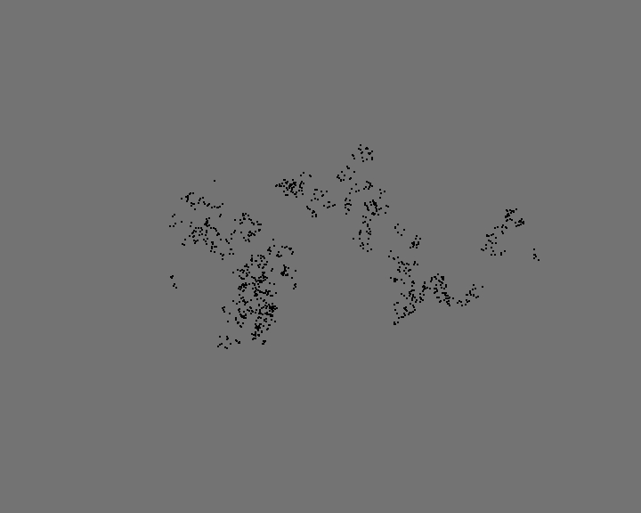
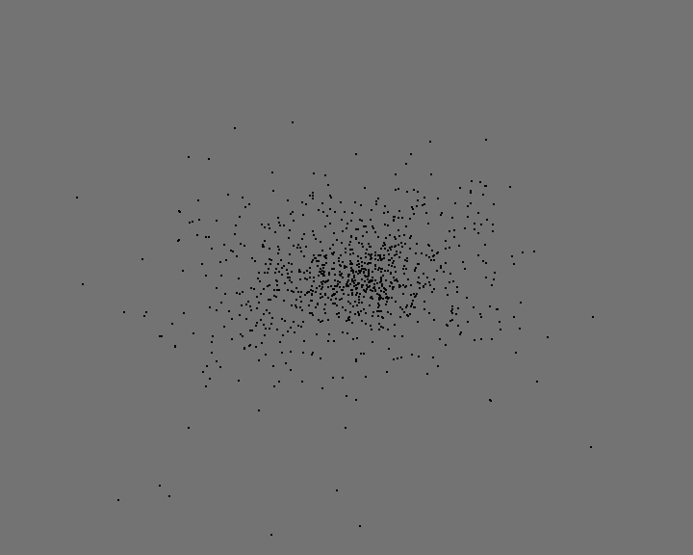
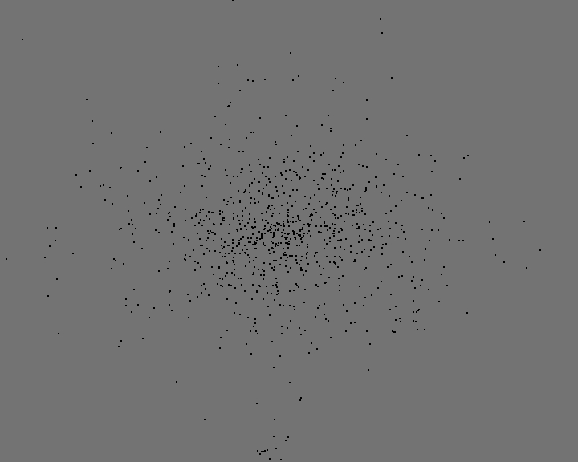
Initial Fractal
SFE = 0.2
Sub-virial Q=0.2
Virial Q=0.5
Still
SFE=0.2
concentrated
fluffy

Slide 27
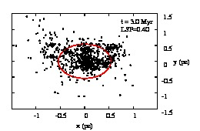
Local Stellar Fraction - LSF
Measured within the half-mass radius of the forming proto-cluster at the time of gas-expulsion

Slide 28
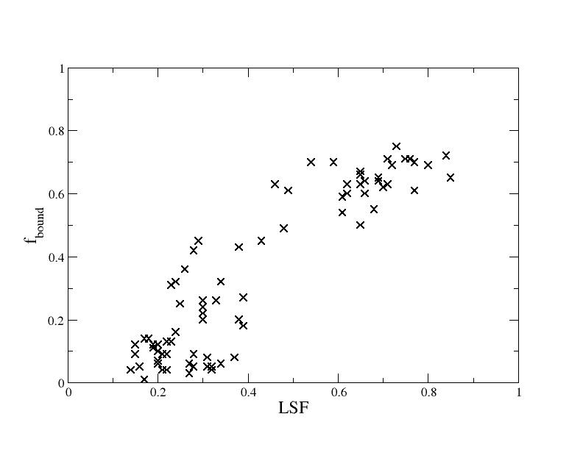
Gas-expulsion after 2.5 crossing times, SFE=0.2
Better indicator
But still some scatter remains
Smith et al. 2011a

Slide 29
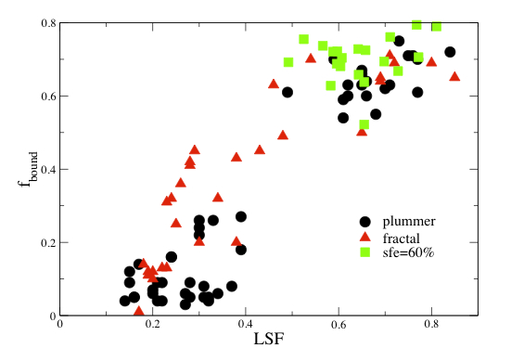
no change with type of distribution
or strength of background potential

Slide 30
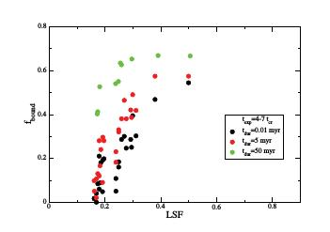
The longer it takes to remove the gas the better the cluster survives
Smith et al. 2013

Slide 31
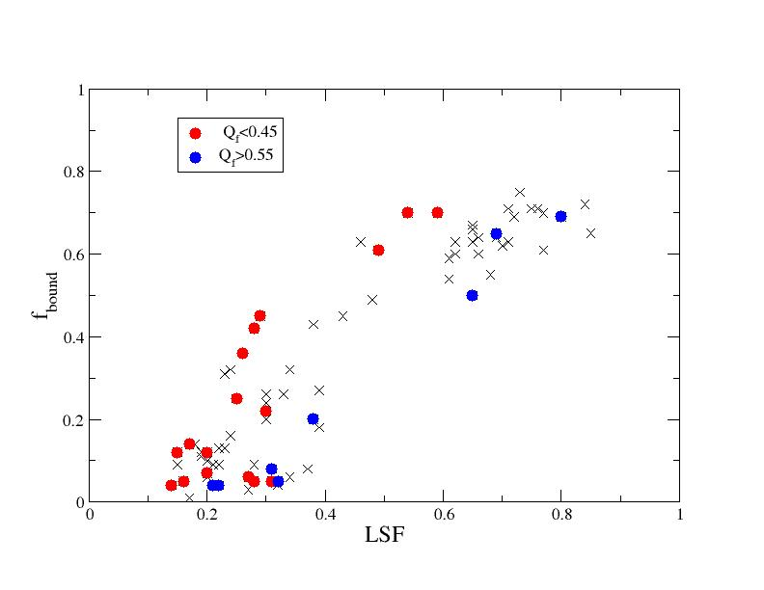
Smith et al. 2011a
Collapsing clusters survive better
Expanding clusters survive poorer
Still some scatter is not explained…

Slide 32
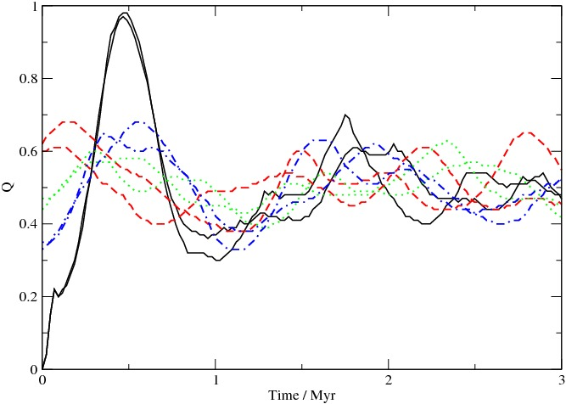
Dynamical State of the Cluster - Q

Slide 33
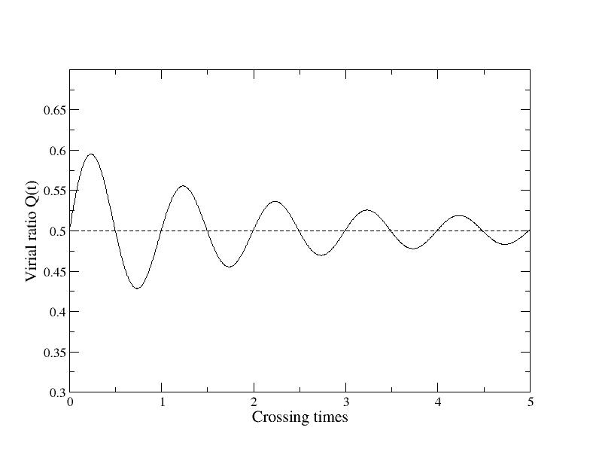
Virial ratio oscillates heavily around virial equilibrium
Even highly sub- or super-virial configurations reach close to virial equilibrium fast (violent relaxation)
But still some oscillations remain for quite a long time
Therefore the exact virial state Q_{f} at the time of the gas-expulsion plays a rôle

Slide 34
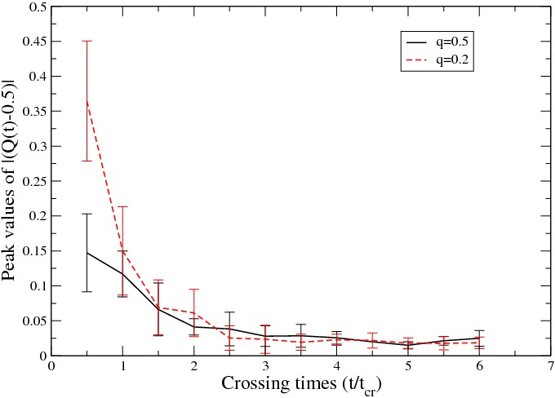
Evolution of Q with time
The dynamical state at the time of gas-expulsion gets closer and closer to virial
If gas-expulsion happens late the dynamics are not important any longer

Slide 35
The dynamic state at the time of the gas expulsion gets closer and closer to virial
If the expulsion of gas occurs late, the dynamics is not important any longer
Juan Pablo Farias

Slide 36
Crossing Time of the global region is not a good indicator for the dynamical evolution
Q-oscillations are a better indicator of the dynamical time of the stars

Slide 37
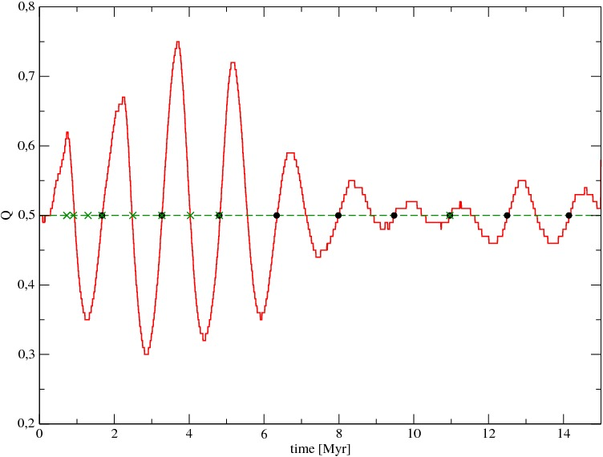
New Timescale t_{Q}
t_{Q} = 0.25
t_{Q} = 0.5
t_{Q} = 1.0
t_{Q} = 7.0
Better description of the timescales involved in the oscillatory behaviour of these systems than Myr or crossing time.
t_{Q} = 3.0
t_{Q} = 0.75

Slide 38
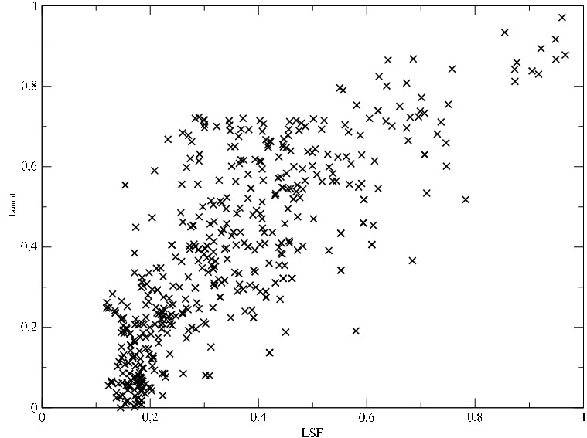
A Closer Look Into Early Gas-Expulsion

Slide 39
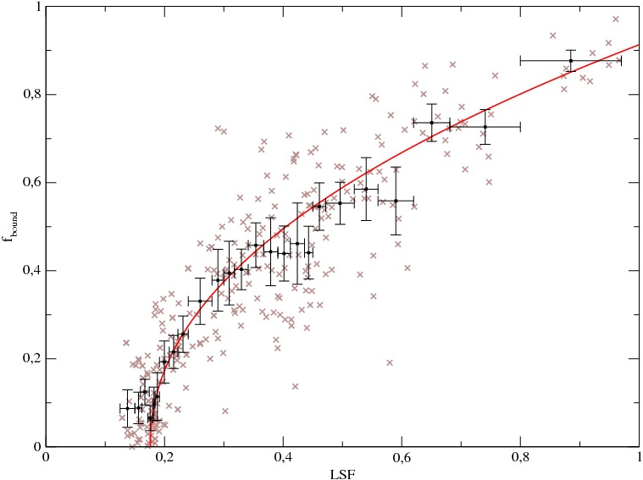
Gas-expulsion at t_{Q} = 1.0 ➔ Q_{f} = 0.5

Slide 40
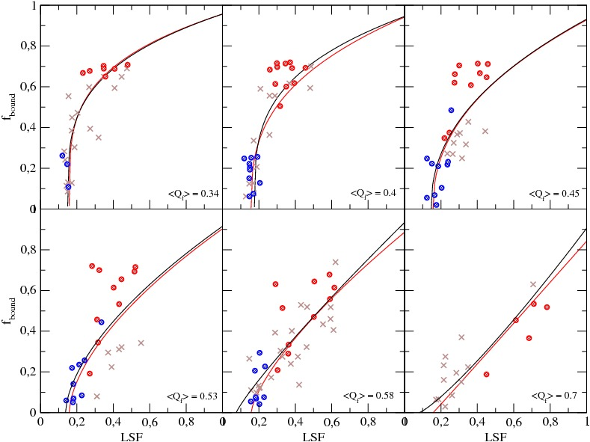

Slide 41
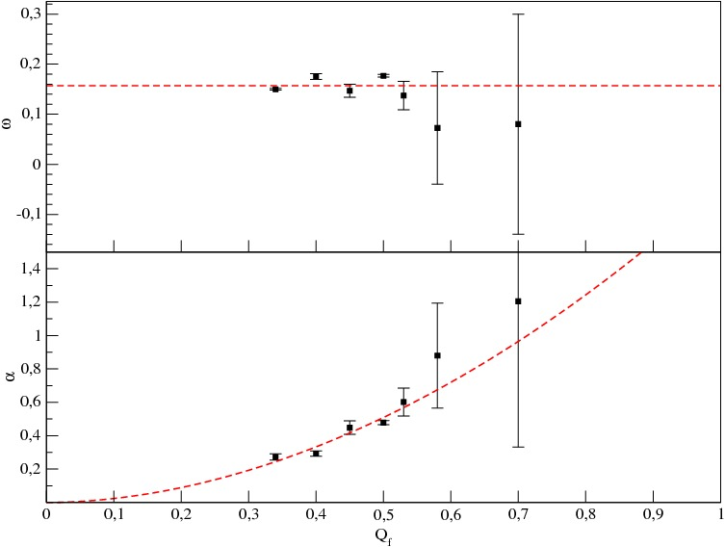

Slide 42
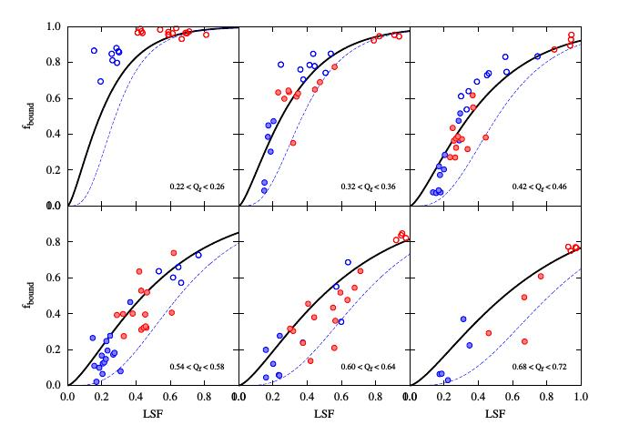
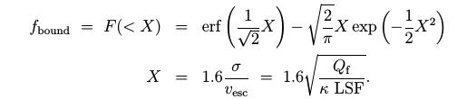
A simple analytic estimation
Theory does not take into account any sub-structure or that gas and stars follow different distributions.
Theory is based on dynamic but global variables (LSF & Q_{f}).

Slide 43
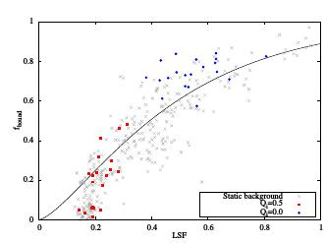
Our theory has some problems:
We underpredict the results at high LSF.
We overpredict the results at low LSF

Slide 44
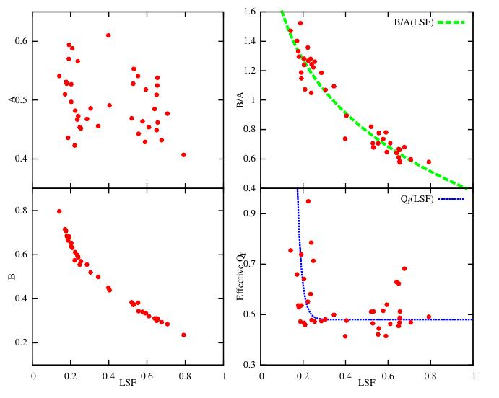
Introducing structural parameters
stars
combined
η(A, B, LSF)
effective Q_{f} measured only for stars which are bound after gas expulsion
gas

Slide 45
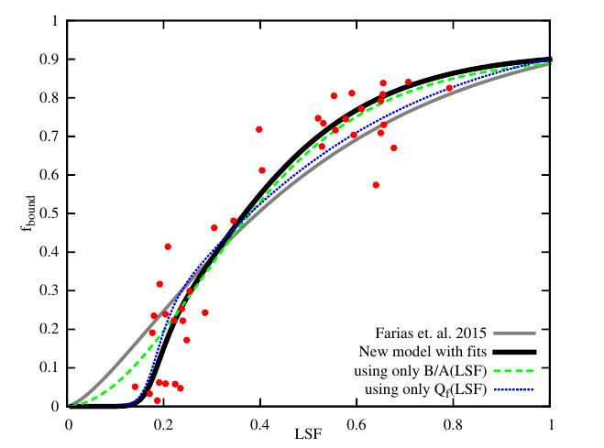
Using η and Q_{f,eff} improves our theory
BUT: requires knowledge of small scale quantities

Slide 46
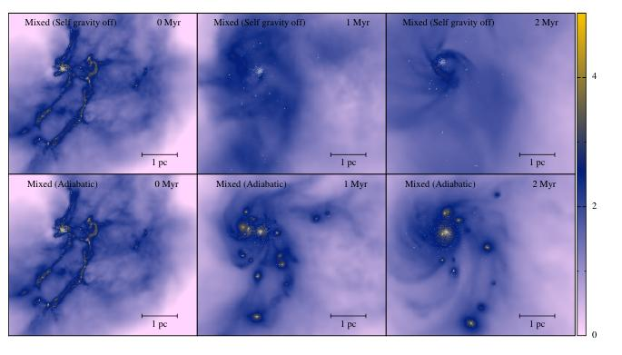
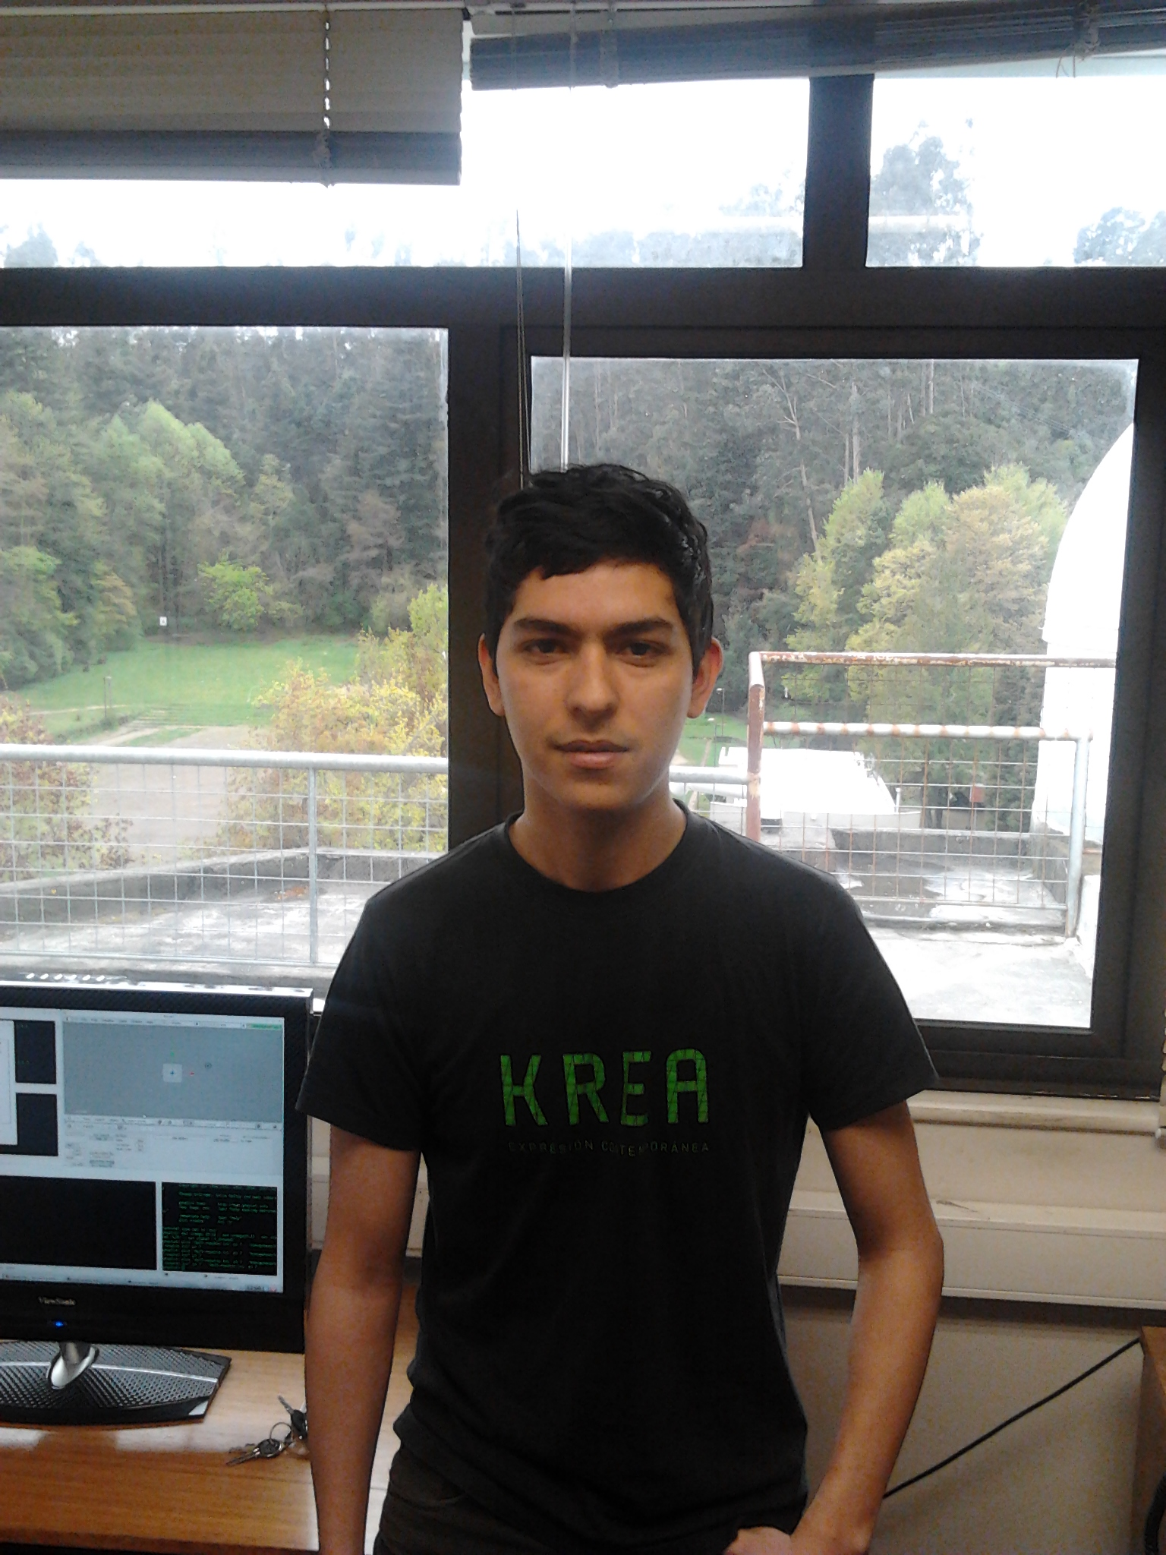
New Simulations (AMUSE):

Slide 47
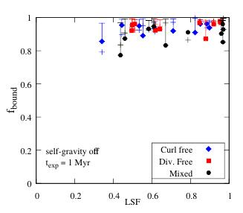
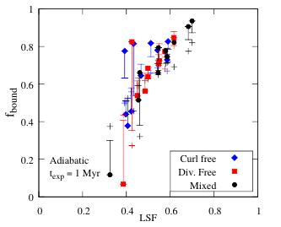
Results:
J.P.Farias, Magister thesis
Simulations without self-gravity of gas have low Q and high LSF.
Adiabatic simulations have broader LSF range and Q close to virial.

Slide 48
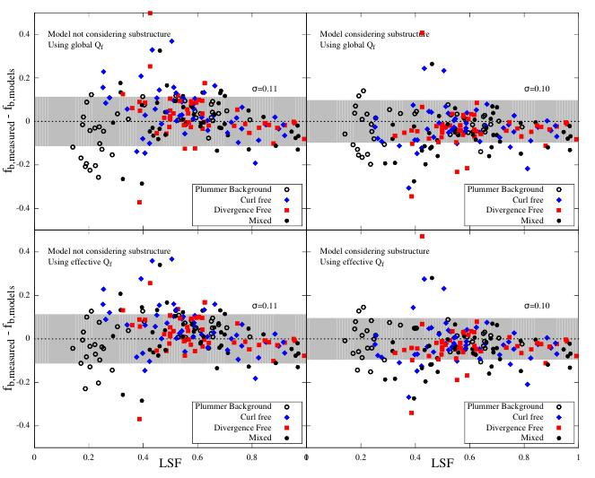
Scatter is always ~10%!

Slide 49
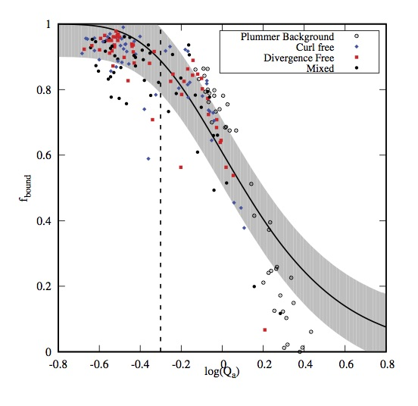

Slide 50
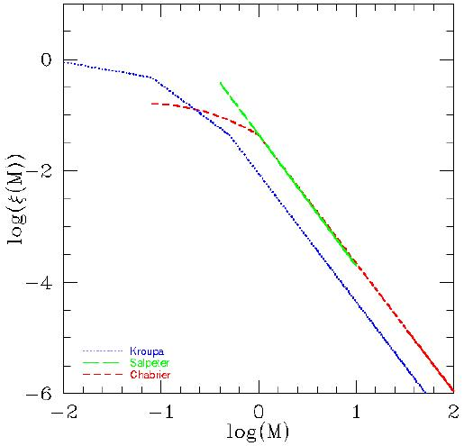
Adding a Kroupa IMF to our simulations
So far all our models had equal mass particles
Now we are investigating the influence of a mass distribution
Kroupa IMF
Matias Blaña

Slide 51
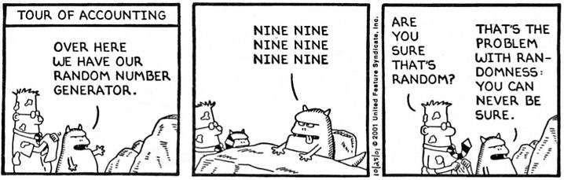
We now form 500 M_{sun} in stars according to the Kroupa IMF
This introduces one more source of scatter as the sampling of the IMF is random
Furthermore, we have the freedom to assign the randomly produced masses to the randomly produced positions in our fractals, randomly…

Slide 52
Same fractal, same IMF sample different assignment of the masses
  Obvious Result:
  Cold fractals survive better than fractals starting out in “virial equilibrium”.
cold
Wrong!
“virial”
Fixed expulsion time,
different Q_{ini}

Slide 53
LSF
Q
virial
LSF
Q
cold
At the fixed expulsion time all cold simulations have a higher LSF and a very low Q_{f}.

Slide 54
Still: Same fractal, same IMF sample different assignment of the masses
  Obvious Result:
  Late gas-expulsion clusters survive better than early gas-expulsion ones
late
Wrong!
early
Fixed initial virial ratio Q_{ini} = 0.2
Different expulsion times t_{exp}

Slide 55
LSF
Q
virial
LSF
Q
cold
At the early expulsion time all simulations have a high Q_{f} and at the late expulsion time a low Q_{f}

Slide 56
The End…?

