Slide 1
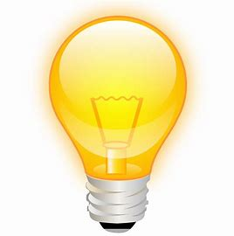
The little “problem I asked in the 1st class ! about number of photons ? Need a light bulb and its “fittings”
Some wires and a battery
a variable resistor, rheostat
Voltmeter and amp-meter
P = IxV, use 50% efficiency and 1 photon carries 2 eV of energy
Assume the lamp to be a point source and regulate the rheostat until you can just still see the lamp, in a very dark room of course

Slide 2
You may be surprised to notice, we can see very few photons
Our eyes have a a huge dynamic range, better tan anything we know how to make ! Normal room light as maybe 10²² photons/sec
This fact was used by Rutherford in his back-scattering experiment which basically was the begging of nuclear physics and finally earned him a Nobel prize, albeit in Chemisty !

Slide 3
Photon Spectrometers, based on diffraction gratings
Roger Hutton
Physics Department, University of Lund, Sweden
And
Department of Astronomy, Beijing Normal University, China

Slide 4
Instruments and wavelength regions
(and a little DIY, do it yourself，for this you need a cornflake box and a DVD disc.）

Slide 5
The electromagnetic spectrum covers the region from microwaves to hard x rays

Slide 6
Questions
What is the difference between a 100 keV hard x ray and a 100 keV gamma ray ?
Soundwaves are not electro-magnetic, but what is an idea of the wavelength .. ??? This leads to my next question …
how to demonstrate diffraction ?

Slide 7
A use of Diffraction, MAX synchrotron lab in Lund

Slide 8
The region of interest for spectroscopy is usually limited to infra-red through to x rays. So, no discussion on micro and radio waves here (but clearly of astronomy interest)
Even so, no one instrument can cover such a large wavelength region.
Sometimes it is the environment, sometimes the dispersion element and sometimes the detector which limits the wavelength region that can be covered.
We will discuss all three of these issues

Slide 9
There are reasons why different regions of the full spectrum have names.
The visible region (3800 - to 7500 Å) is obvious, as are the infra-red and ultra-violet regions.
Why the names ‘vacuum ultra violet”, “soft x ray”, and “x ray”? Vacuum ultra-violet begins at around 2000 Å. Quartz stops transmitting light at about this wavelength, normal glass is not transparent from around 3500 Å. But this would not mean a vacuum is needed.

Slide 10
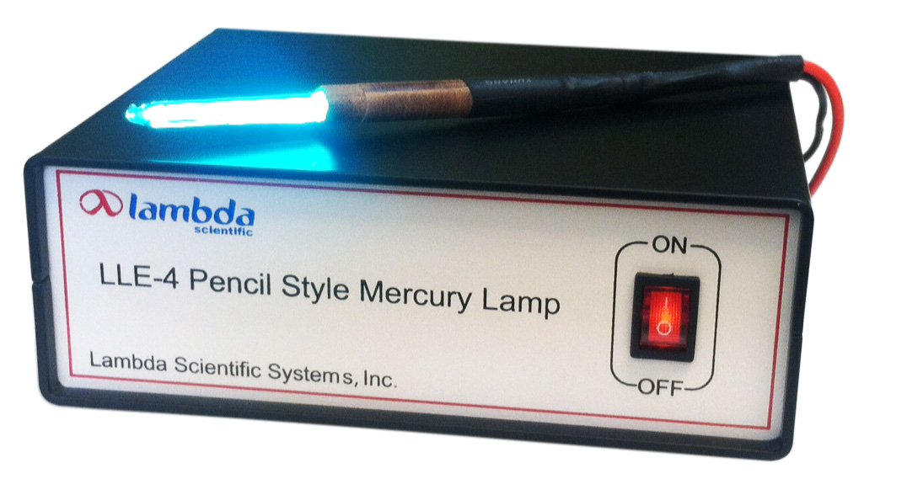
Normally I do a demonstration now showing why we call part of the spectrum the vacuum ultra-violet. All you need is a simple Mercury lamp, but you need the one with the Quartz window

Slide 11
The oxygen molecule is broken down at around 1850 Å and hence photons are absorbed and there is little transmission. Some of the broken O₂ molecules form O₃, which has a distinctive odor and can be noticed around photocopying machines (demonstration, when I can !!!)
The soft x ray region begins at around 250 – 300 Å and extends down to around 10 Å. This is when normal incidence spectrometers are no longer useful and grazing incidence must be used. The x ray region begins at around 10 Å where grating based spectrometers are no longer useful and crystals should be used.

Slide 12
The first diffraction gratings were ruled on plane blanks. It is easy to imagine, based on the grating equation, how a spectrometer based on a plane grating may be constructed. The grating equation will be discussed later and can be written as:
mλ/d = sinα + sinβ
The angle α defines the angle of incidence for the light impinging on the grating surface, the grating could be as simple as a DVD disc. m is the so-called diffraction order

Slide 13
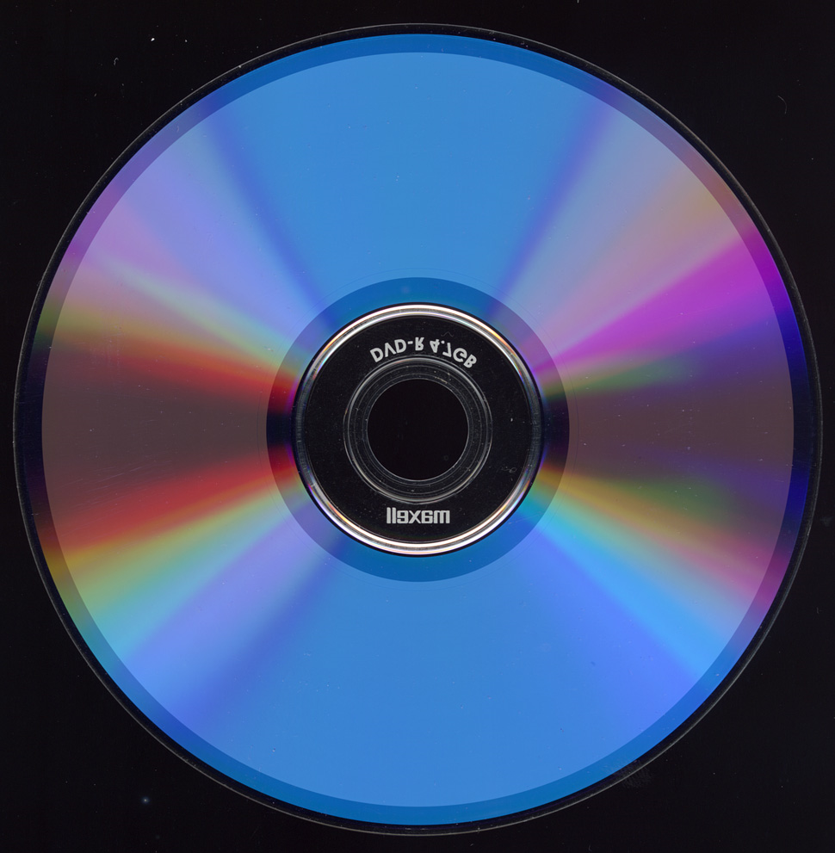
A perfectly good grating
Any guess as to the groove density ??
How many lines/mm？？

Slide 14
It is easy to define the angle of incidence if the light falls on the grating in the form of a parallel beam. This is easy to accomplish, just use a light source at an infinite, or very great, distance from the grating, such as the Sun. If the object to be studied is closer, then we can make use of Newton’s equation:
1/f = 1/u + 1/v
f = the focal length of a concave mirror (for example)
u = the distance to the object
v = the distance to the image
If v = f, then 1/u must be = 0, i.e. u is at an infinite distance.

Slide 15
So, we can make a parallel beam of light by putting an entrance aperture, usually a slit in the case of a spectrometer, at the focus of a concave mirror.
The revers of this tells us how to find the focal length of a concave mirror or lens. The parallel beam is then directed towards the grating where the light is dispersed based on the grating equation.
A spectrum can then be observed by looking, with one’s eye, along the direction defined by the diffraction angle (β). If it is more advantageous to record the spectrum on a photographic plate or CCD detector a second concave mirror is needed.

Slide 16
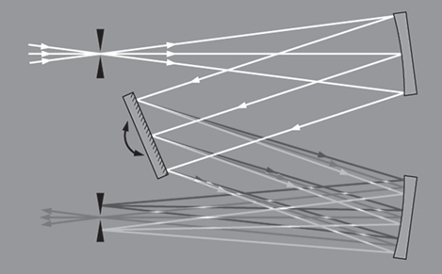
If this second mirror has the same focal length as the first one, then there are some aberration cancellations, this set up shown below is the Czery-Turner mounting of a plane grating.
One of the classic mounts of the plane grating, known as the Czery-Turner mounting.

Slide 17
This simple plane grating spectrometer has a very wide wavelength coverage.
The short wavelength limit is defined by the need for three reflections.
The long wavelength limit is basically defined by the grating equation, mλ/d = sinα + sinβ, here sinα + sinβ can never be greater than 2, so, for 1st order diffraction (m=1) λ/d must also be less than or equal to 2.
Upper limit is around 16 microns for a 1200 l/mm grating

Slide 18
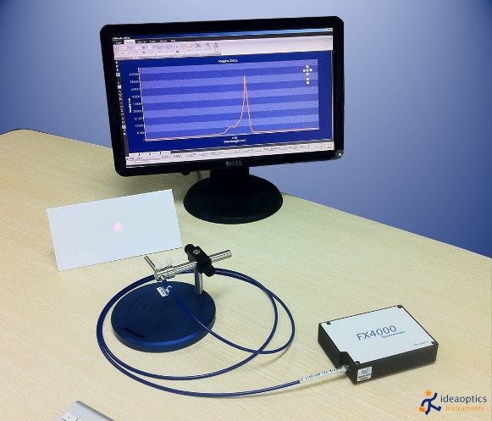
A very compact Czerny-Turner spectrometer.
spectral resolution is about 10 Ấ and the range covers 2000 – 11000 Ấ.
Such instruments have many uses, even fusion plasma physics.
The grating mount allows to work in the infra-red, but the detector needs to be thought about.

Slide 19
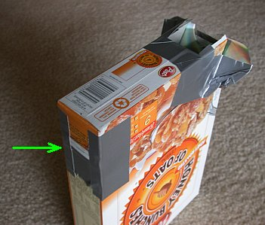
A simple spectrometer, but good enough to resolve the Fraunhafer absorption lines in the Sun, can be made using a normal DVD and a cardboard box
Really no need for the box when looking at the sun

Slide 20
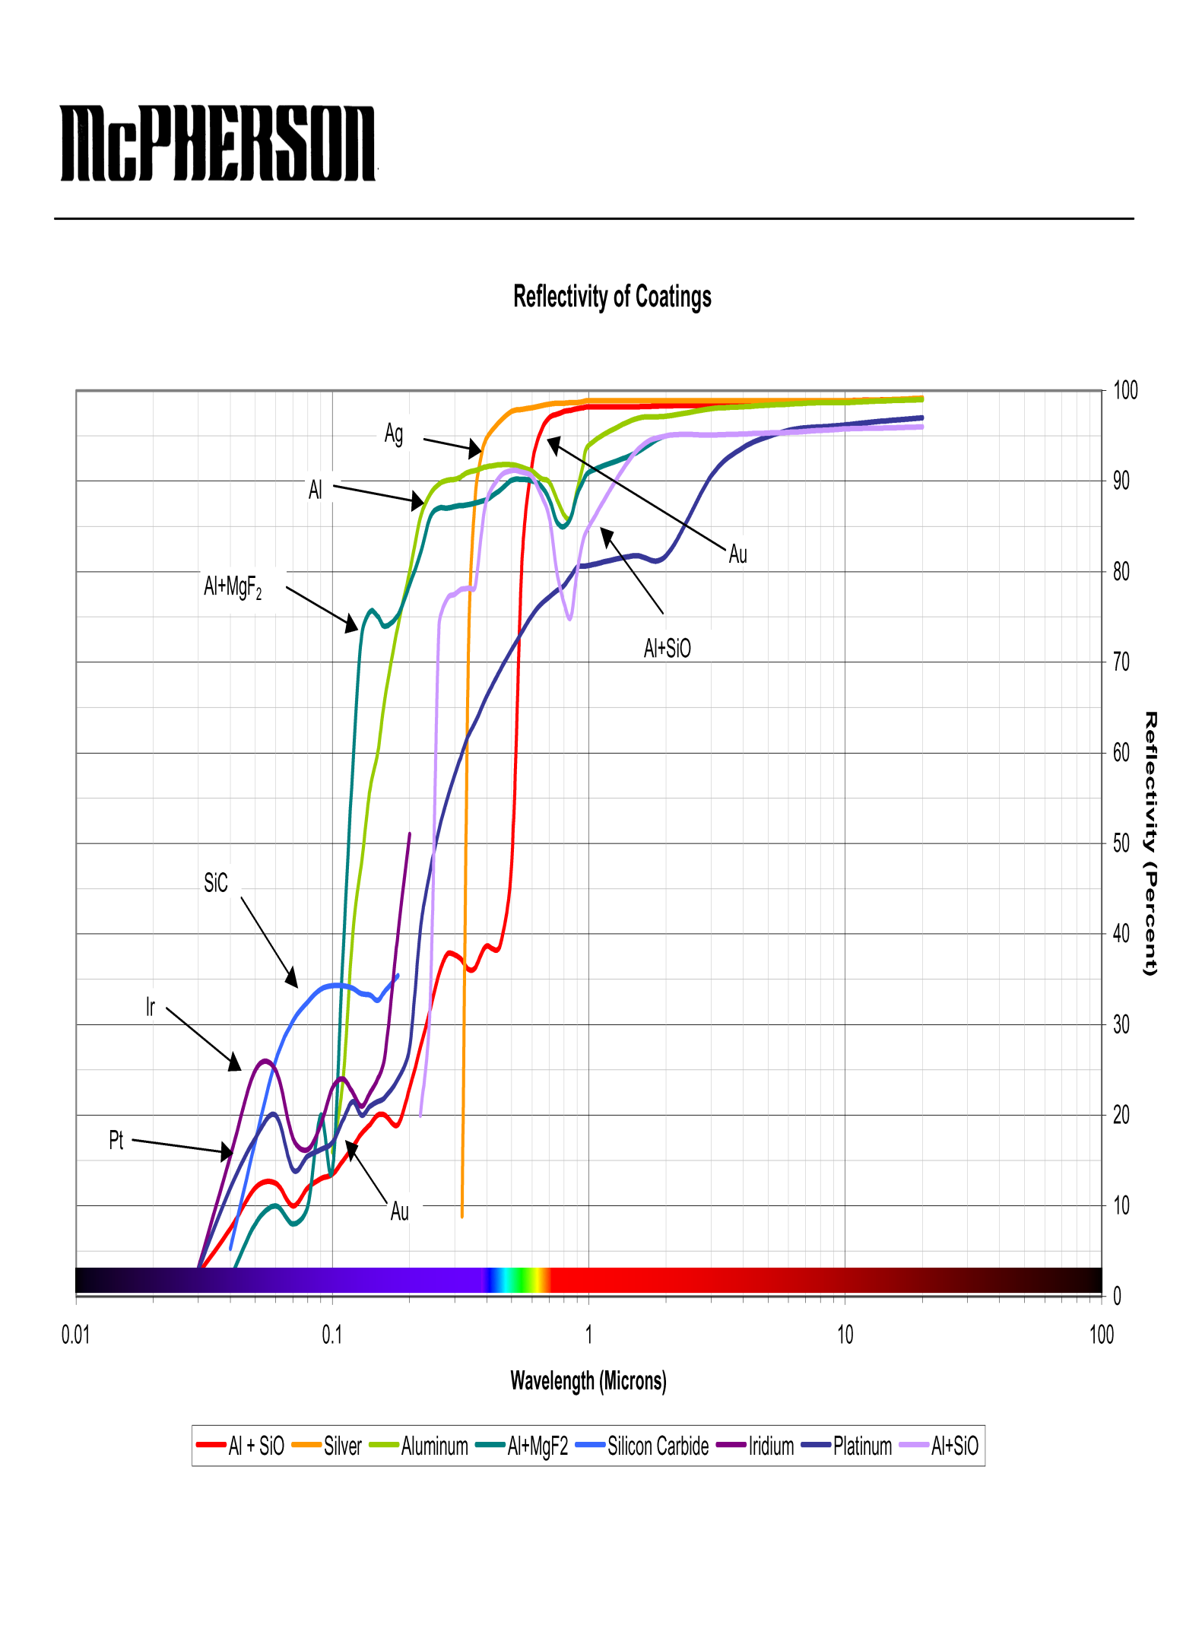
In the early 1880’s Henry Rowland managed to rule a grating on a concave blank and basically revolutionized spectroscopy. Why this is so can be understood from the below figure (McPherson) Reflectivity vrs. wavelength of any morror materials

Slide 21
The last figure showed us Reflectivity of most mirror coating materials under normal incidence conditions. This shows that to do spectroscopy below 1000 Ấ using an instrument based on a plain grating is very difficult, as there is a minimum of three reflections, unless the light source is very bright.
Reflectivity becomes very low.
Using a concave grating there is only one reflection to worry about.

Slide 22
Where does the grating equation come from, where does the law of reflectivity come from ?
Fermat's Principle: Light follows the path of least time

Slide 23
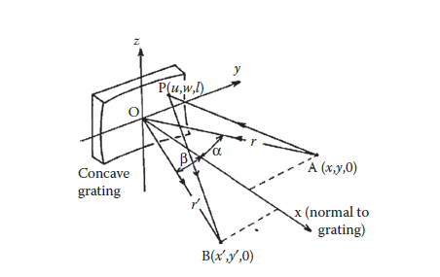
Similarly Fermat’s principle can be used to derive the imaging properties of a concave grating. The light path to be optimized is shown in the figure below.
The geometry of a concave grating spectrometer

Slide 24
AP)² = (x-u)² + (y-w)² + (z-l)²
(PB)² = (x’-u)² + (y’-w)² + (z’-l)²
These are put into spherical co-ordinates using:
x = rcosα y = rsinβ
x’ = r’cosα y’ = r’sinβ
There is just one extra thing here. We are not looking for true imaging, only that the light arrives at the image point in phase. Not all the grating surface reflects light and this is introduced by a wmλ/d, so the distance to minimize is:
F = (AP) + (PB) + wmλ/d

Slide 25
This should be minimized with respect to both w and l,
i.e. δF/δw = δF/δl = 0
The first order solution is:
mλ/d = sinα + sinβ
which is the so called grating equation and which all gratings must follow, plane or concave.
m = diffraction order, an integer, m = 0 means basically mirror reflection. Called zero order diffraction and also contains a lot of light which is useful in spectrometer alignment.
λ = wavelength
d = line spacing of the grating
α= incidence angle
β= diffraction angle

Slide 26
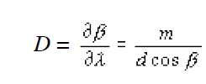
This very simple equation tells us a lot about the practical limitations of a grating based spectrometer. A very useful number is the so-called plate factor. Plate from comes from when the photon detector would have been a photographic plate and its units are usually quoted in Å/mm. The plate factor comes from differentiating the grating equation w.r.t. β (α is usually fixed by the geometry). This gives us the angular dispersion:

Slide 27
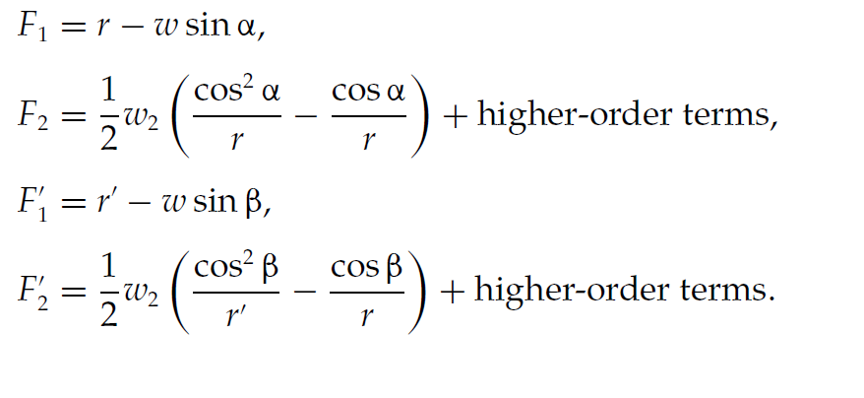
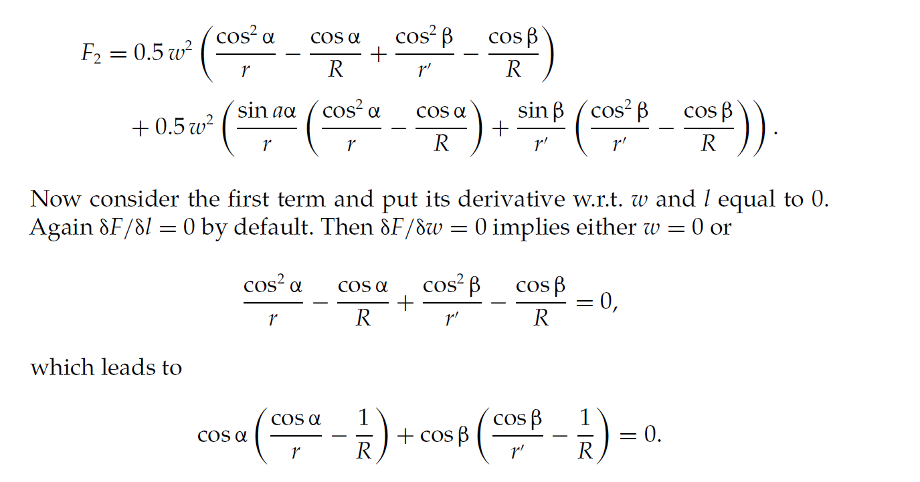
The F1 terms were discussed before as the grating equation. The F2 terms represent everything else. The bracketed parts give the 2nd order solution and the basic geometry of the concave grating operation.

Slide 28
Note, there are other solutions
The full analysis can be found in Beutler’s paper from 1945.
These two equations define a circle known as the Rowland circle.
The object, light source can be put anywhere on the Rowland circle and the image (spectrum) will also appear on the same circle. The higher order terms in the above equation define aberrations to the spectral image. One example of an aberration is illustrated, next slide, that of spherical aberration.

Slide 29
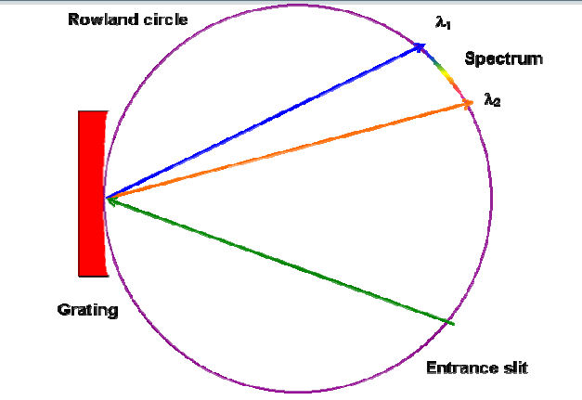
The last two equations define a circle called the Rowland circle and this pretty much defines grating spectrometers.
For wavelengths greater than around 300 Å the value of the incidence angle, α, is kept small, typically 7.5 degrees, and called a normal incidence spectrometer
For wavelengths less than around 300 Å the value of the incidence angle, α, is large, typically 88 degrees, and called a grazing incidence spectrometer

Slide 30
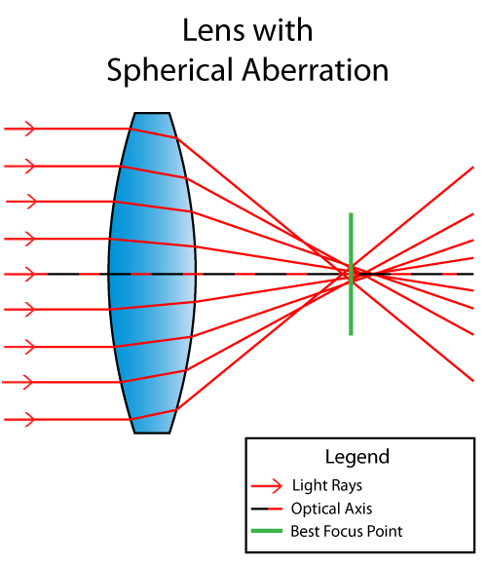
Aberrations
Come from higher order terms in the expansion of the optical path length
This illustrates spherical aberration. The aberration increases as the size of the lens increases with respect to the focal length, i.e. for smaller f/numbers. This can be, and is, compensated for using a number of optics, a compound lens, but will always exist for a single lens, mirrors or a spherical grating for that matter.

Slide 31
Actually the resulting aberration expressions for multi-element optical systems are too difficult to deal with and the easier solution is ray tracing.
Ray tracing- programs use the basic rules of reflection, refraction and diffraction to follow a large number of optical rays through the system/
There are many ray tracing sets of codes, we have used ZEMAX (web address below). ZEMAX is a commercial set of codes but a fraction of the total is free to down load and use and is enough for the design of grating based spectrometers, see the Phd thesis by Z. Shi.
https://my.zemax.com/en-US/
how to do ray tracing before computers ?

Slide 32
Such instruments (normal incidence) are based on an incidence angle of around 7.5 degrees. The smaller this angle is the lower the aberrations will be (defined by the third order terms of the grating imaging term).
However, if the angle is too small, then the exit slit assembly may be very close to the entrance slit assembly. The simplest geometry is an incidence angle of around 7.5 degrees and a photographic plate, bent around the Rowland circle, as the detector. However, this would require a fairly large vacuum vessel if the instrument was to cover a large wavelength rang. Paul McPherson came up with a novel scheme to turn a normal incidence spectrometer into a monochromator by rotating and moving the grating at the same time to keep the Rowland circle focused at the exit slit.
The current version of this arrangement uses a CCD camera as the entrance “slit”. Under most conditions that fact that the CCD chip is not matched to the Rowland circle in not noticed, let alone a problem.

Slide 33
A problem that may arise using， mainly, normal incidence spectrometers is that of higher order lines.
Remember the grating equation: mλ/d = sinα + sinβ. If d,α and β are fixed then mλ = constant. m can be 1,2, 3 etc, first, second and third order diffraction with correspond wavelengths of λ, λ/2，and λ/3 etc.
We can get some help by using optical filters. There are short wavelength cut-off, long wavelength cut-off and band pass filters available, see:
http://www.opticalfilters.cn/Bandpass-filter.html

Slide 34
Filters in the vuv/soft x ray regions are more difficult, We have used thin carbon filters to block visible light, which can drown the real signal in grazing incidence spectrometers. These filters can be made in the lab. from carbon films evaporated onto glass slides. See www.goodfellow.com. This company produces materials for “Scientific and Industrial Research and Manufacturing”.
Wavelengths below around 170 Å can be blocked using a filter made by evaporating Al on a polypropylene substrate (ygwu@tongji.edu.cn, TongJi University, Shanghai).
To examine transmission of elements of maybe use of filters you can use free software. There are two easily available routes to take:

Slide 35
(1) the set of codes developed by the European Synchrotron Radiation Facility called “xop” (x ray optics presumably) http://www.esrf.eu/computing/scientific/xop2.1 (you may have to register to download this software)
( 2)There is a second way to study the interaction of materials with x ray radiation. This is an online resource at the Lawrence Berkeley Center for x ray optics (http://henke.lbl.gov/optical_constants/ ).
This set of Apps from LBL is very useful to understand how different materials work at different wavelengths and what can or may be used as filter material.
(As an example we show reflection from a gold surface at 10 and 88 degrees incidence and for a smooth and rougher surface (2 nm), see the next slide, or run the app yourself !

Slide 36
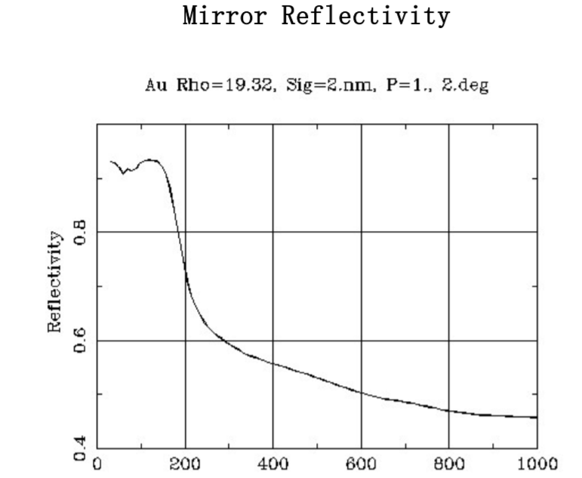
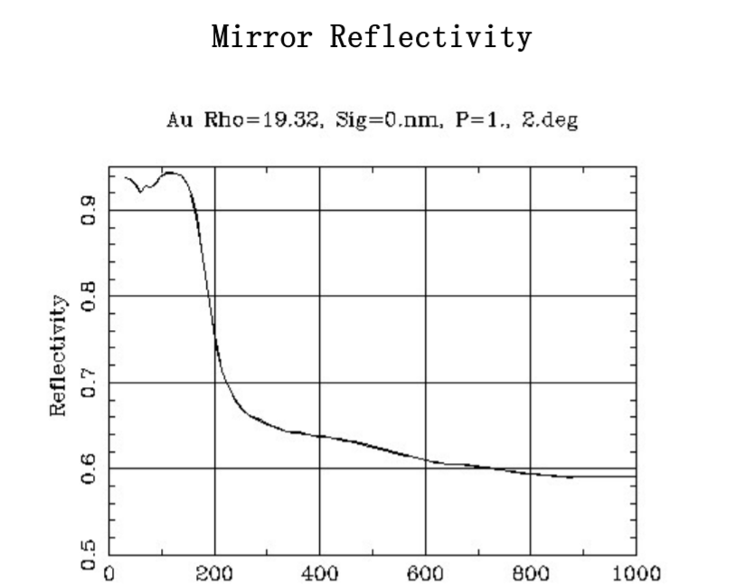
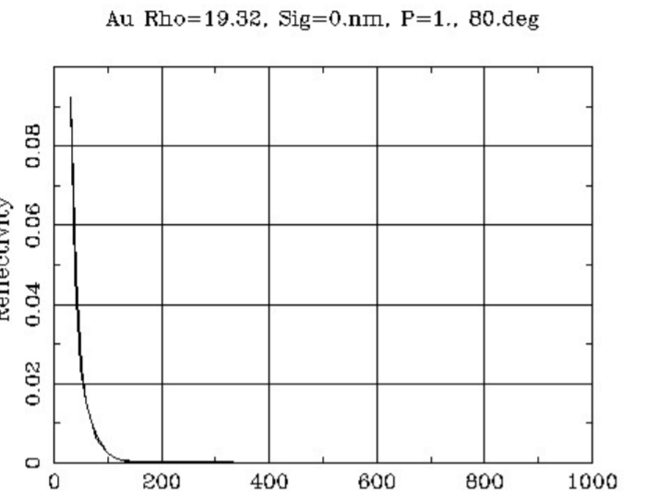
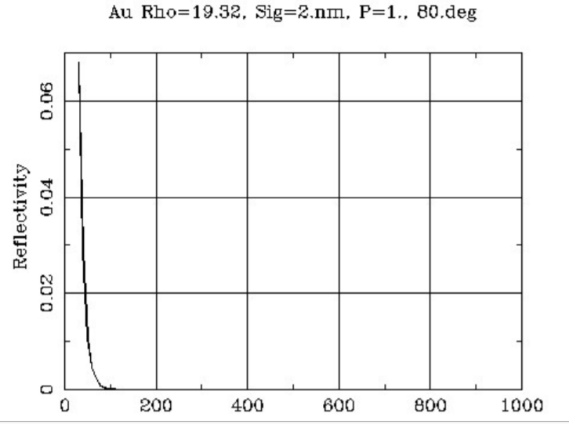

Slide 37
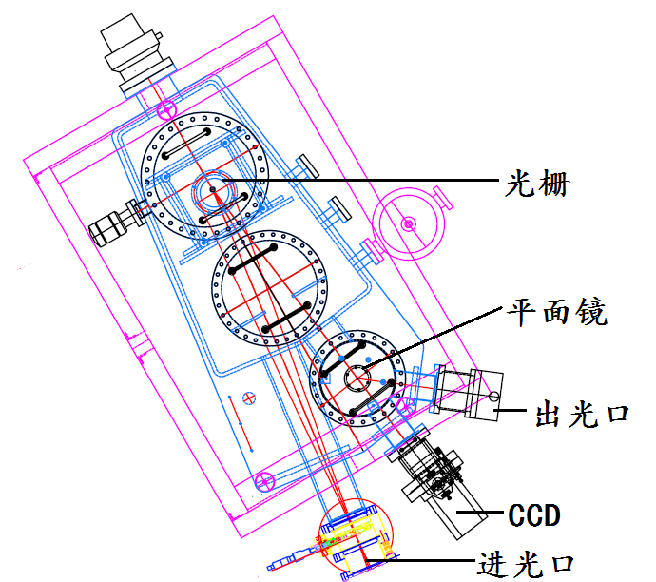
A good example of a normal incidence spectrometer is McPhersons 1 meter instrument, model 225. An example of the 225 being used at a fusion device can be read in “Spanish fusion spectroscopy”.
The basic design of the McPherson 225 1 meter normal incidence spectrometer.

Slide 38
Properties of the McPherson 225 with different gratings. The wavelength range is given from 30 nm. The resolution is in nm and the dispersion nm/mm.
Some people prefer to use nm instead of Å, a factor of10 different.
nm (10⁻⁹ m) is the official unit, Å is to commemorate the Swedish scientist Anders Ångström, I prefer Å
Grating (G/mm | 3600 | 2400 | 1800 | 1200 | 600 | 300
Wavelength Range | 100-nm | 150-nm | 200-nm | 300-nm | 600-nm | 1.2-um
Resolution | 0.005 | 0.008 | 0.01 | 0.015 | 0.03 | 0.06
Dispersion | 0.28 | 0.42 | 0.56 | 0.83 | 1.66 | 3.33

Slide 39
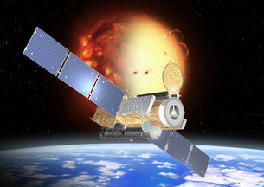
Hinode（Solar-B）http://solarb.mssl.ucl.ac.uk/SolarB/
Mission is to study the sun and its corona.
It uses a normal incidence spectrometer operating in two wavelength intervals, 170-220 Å and 250 – 290 Å

Slide 40
http://solarb.mssl.ucl.ac.uk/SolarB/nuggets/nugget_2020oct.jsp
Hinode/EIS Measurements of Active Region Magnetic Fields
E. Landi (University of Michigan), R. Hutton (Fudan
University), T. Brage , and W. Li (Lund University)
W. Li is now in Beijing at the National Observatory
You may be wondering, why normal incidence ?? Well, better optics and a grating coated with a multi-layer structure give good reflectivity, but fading below 180 Å

Slide 41
The other common Rowland circle geometry is that of grazing incidence. Here the incidence angle is usually of the order 86-88 degrees.
This means that the zero-order, or mirror reflection, is also at the same high angle. This geometry comes about due to the lack of reflectance at small angles of incidence for short wavelength light.
Both the height and width of the grating are defined by the need to keep aberrations to an acceptable level. It is not uncommon for these instruments to operate at around f/50.

Slide 42
Grazing Incidence spectrometers
A quick study of figure “McPherson” shows that reflectivity, at least under normal incidence conditions, becomes very small for short wavelengths.
However, it turns out that at very high angles of incidence the reflectivity goes towards 100%. Therefor for spectroscopy at short wavelengths it is very beneficial to use grazing incidence instruments. The incidence angle can be around 88 degree. From the grating equation we can find that the diffraction angle will also be very high, 88 degrees for the zero order reflection.
This geometry was the norm below around 400 Å for many years. However, problems arose with the development of CCD cameras and other 2D type photon detectors.

Slide 43
The problem being that the CCD chip should be tangential to the Rowland circle and hence the incidence angle on the surface would also be very high.
The CCD chip would then act as a mirror and reflect many of the photons it was meant to detect. A simple solution to this was the place the CCD at 90 degrees to the incoming light, i.e. NOT tangential to the Rowland circle. (Physica Scripta, Volume 1999, T80B ) Better to be lucky than smart !
This geometry has slightly broader line widths, and hence worse resolution, towards the edge of the chip, but this was acceptable in many experimental situations, and adapted by McPherson for one of its products.

Slide 44
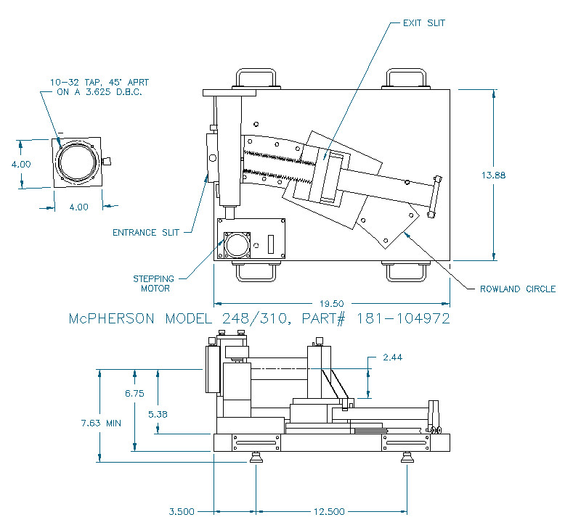
Grazing Incidence
The McPherson 1 meter grazing incidence spectrometer.

Slide 45
Grazing incidence spectrometer have been used on space missions
A 3 Meter grazing incidence spectrometer was used many years ago, now in a museum in the US, I think

Slide 46
Under normal grating conditions gazing incidence spectrometer suffer from very bad aberrations. The worst of the aberrations being astigmatism. The vertical and horizontal focuses are far apart, meaning the image should be focused at the slit in the direction of dispersion (usually horizontal). The vertical image is then far from being in focus and a lot of light is lost, as it will not enter the spectrometer.
This problem can be avoided by using non-concave optics, such as a toroidal grating. The difference between spherical and toroidal optics is illustrated below.

Slide 47
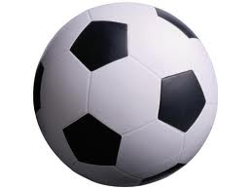
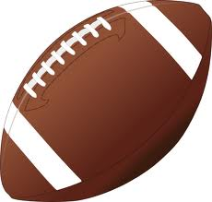
Spherical vrs Toroidal optics
Spherical “optic”
Toroidal “optic”
As the toroidal optic has different radii of curvature in the horizontal and vertical directions it can focus in both planes at the same image distance, even for a large angle of incidence.

Slide 48
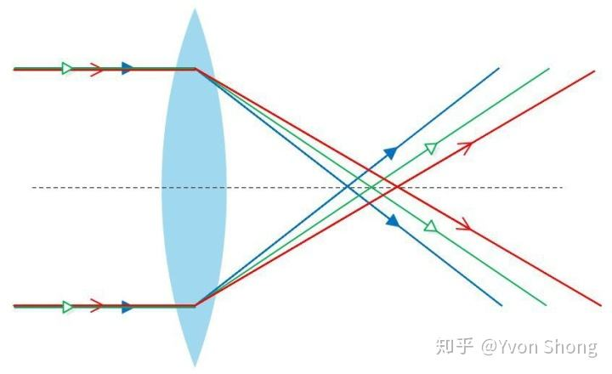
Astigmatism,

Slide 49
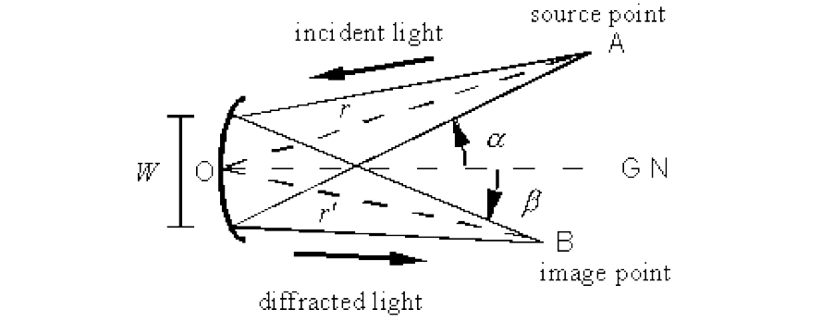
Spherical gratings used at grazing incidence are very limited in the area used due to the aberrations meaning the light collection angle (or f/number) is very small, quite often f/50.
The f/number is defined by the length of the optic/focal length. F/1 is very good and usually very expensive, or was in days gone by, mobile phones appear to have good lenses.
The F/number is a measure of the light collection ability of a mirror or lens. It is defined as the distance to the focus, r’, divided by the width of the optic, w. F/1 has very high light collecting ability.

Slide 50
So far I did not mention one of the most important spectrometer properties, the resolution, (λ/δλ)
I did mention a quantity called the “plate factor” which tells us the dispersion over a 1mm region, Å/mm. This was basically obtained by differentiating the grating equation
There are two “words” you need to know
resolving power and
(b) resolution

Slide 51
(a） resolving power
This comes from diffraction grating theory and is just the number of groves illuminated
For a 10 cm grating with 1200 groves/mm then the resolving power is 100 x 1200 = 120000, if all groves are illuminated.
Such gratings are used in 1 meter normal incidence and Czerny-Turner spectrometers and there is NO WAY the resolution is this good

Slide 52
(b) resolution
Resolution takes into account other properties, like slit width and detector pixel sizes etc.
One comment here, spectrometers should be designed according to the properties of the most expensive component, usually the detector, for example a CCD camera

Slide 53
A more interesting solution was offered by Kita and Hirada who raised the question, “what happens if the grating line spacing does not need to be constant over the surface”? This lead to the ideas of aberration corrected and flat field spectrometers.
Please read the two documents, Zhan’s Thesis and Zhan’s spectrometer for a good description of flat field gratings，also the two papers by Harada

Slide 54
Scientific grade CCD chips have, typically, 13.5
or 25 micron pixels
As we need, typically, 3 or 4 data points (pixels) to define a line and find its center, t ere is little use making the spectrometer entrance slit less than 3 x 13.5 (40) or 3 x 25 (75) microns
Using this together with the plate factor gives us the experimental line width and hence also the resolution

Slide 55
example

Slide 56
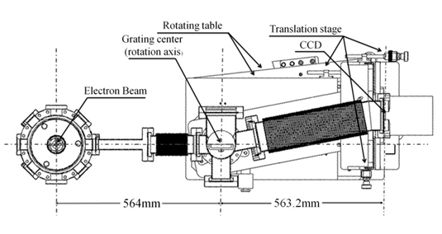
Flat field spectrometer， uses a variable line spaced grating

Slide 57
hitachi manufacture a number（not many）of such grating. Basically only two focal lengths
Due to the advent of synchrotrons .. Many options were needed for gratings and spectrometers in the soft x ray region
A number of companies came to the “rescue”, one being Jobin-Yvon, now almost anything is OK, just to pay ! Sad these spectrometers seem to have stayed at synchrotrons

Slide 58
Other solutions to the imaging properties of a concave grating
There is a second, practical, solution to the imaging properties of a concave grating.
There may be other solutions but none that have a practical use have been developed so far. This second solution is based on an object at an infinite distance (or a parallel beam of light). In this solution called the Wadsworth mounting the spectral image is diffracted close to the grating axis, i.e. close β = 0 degrees, see the figure above. The line shape is best on the axis, but as long as β is small the spectrum is still OK.

Slide 59
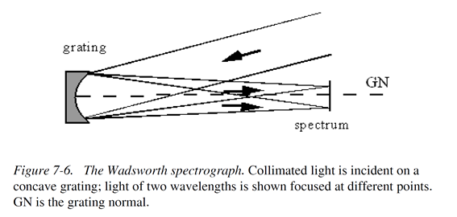
The Wadsworth Mounting
H mounting
The imaging properties of a concave grating used under the Wadsworth mounting geometry.
The actual image “plane” is a curve given by:

Slide 60
The Wadsworth mount on its own has not been very useful, except to maybe demonstrate the solar spectrum using just a single grating. It came into good use in a type of Czerny-Turner type where the plane grating is replaced by an Echelle grating and the concave grating takes the place of the 2nd mirror.
The groves of the concave grating are oriented perpendicular to those of the echelle and the resulting spectrum has a 2D nature. Such instruments are called Echelle spectrometers.
The most famous being onboard the Hubble space telescope. These spectrometers can have very high resolution and cover a large spectral region for each recording

Slide 61
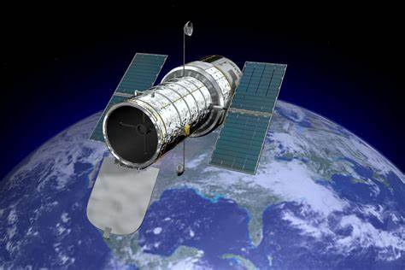
Hubble space telescope, the high resolution spectrometer onboard is an Echelle instrument

Slide 62
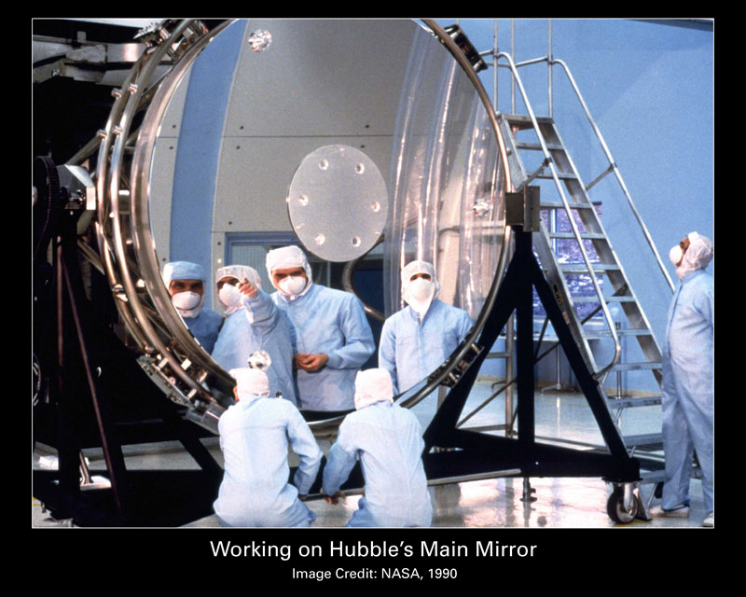
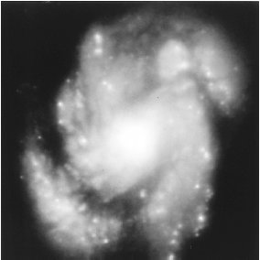
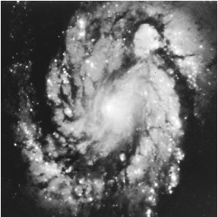

Slide 63
Echelle Gratings
We go back to the grating equation: mλ/d = sinα + sinβ
Normally m is a small number, 1 or 2 for example. Then, as discussed before mλ/d must be less than 2. If m = 1 then λ/d is less than 2.
What would need to happen for m to be very large, say 100. Then 100x λ/d must be less than 2, but could be 1. So, 100λ/d = 1, or d = 100λ. For λ = 5000 Å, then d = 0.05 mm, which means a grating with 20 lines/mm, such gratings are called Echelles.
Such gratings are not so easy to manufacture, as d must be very consistent, otherwise m will vary over the surface of the grating. As Echelles are usually mounted in something like a Czery-Turner arrangement α = β and the grating equation is then mλ/d = 2sinα. Many of the properties of the Echelle grating can be derived from this.

Slide 64
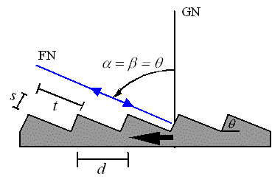
A schematic diagram showing the operation of an Echelle grating. For a typical commercially available grating θ = 63 degrees and d = 1/31 mm then at 4000 Å the diffraction order is n = 144.
The following is from the diffraction grating hand book chapter 11

Slide 65
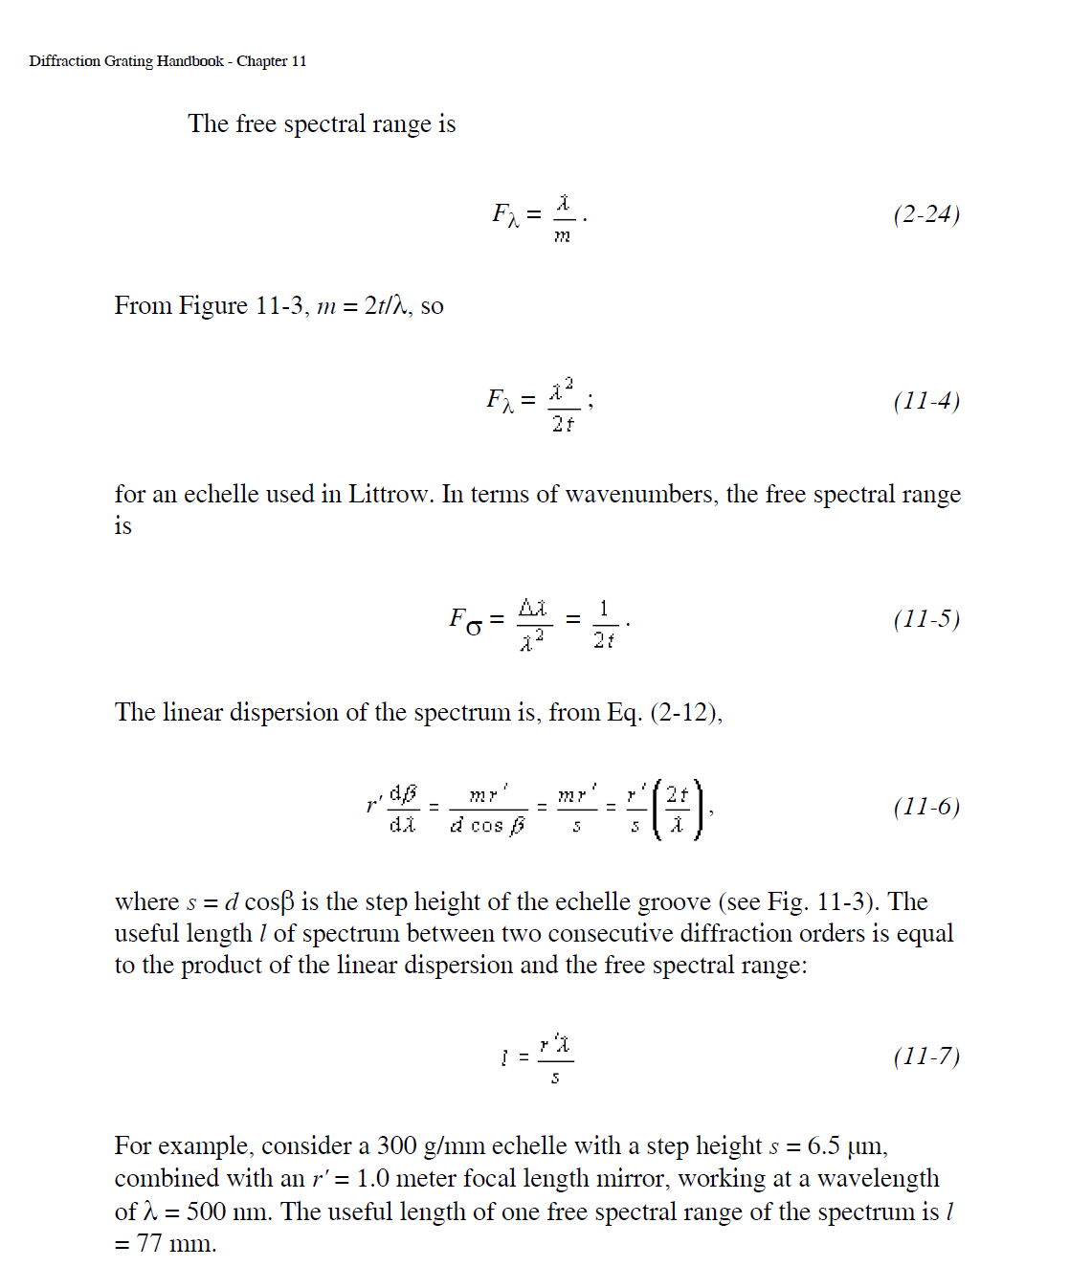
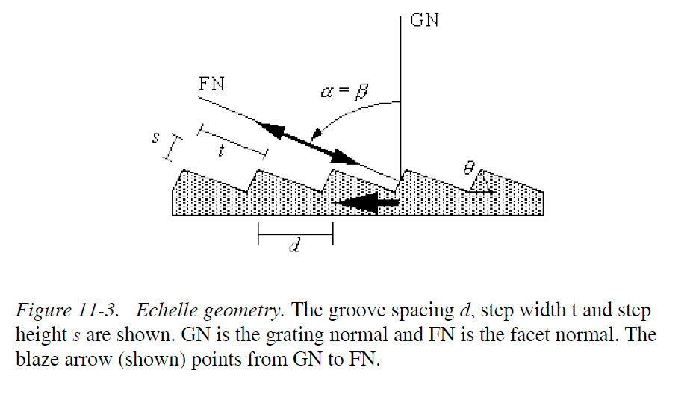

Slide 66
Replacing the 2nd concave mirror by a concave grating wit the grooves crossed compared to the plane (echelle) grating leads to the basic echelle spectrometer design

Slide 67
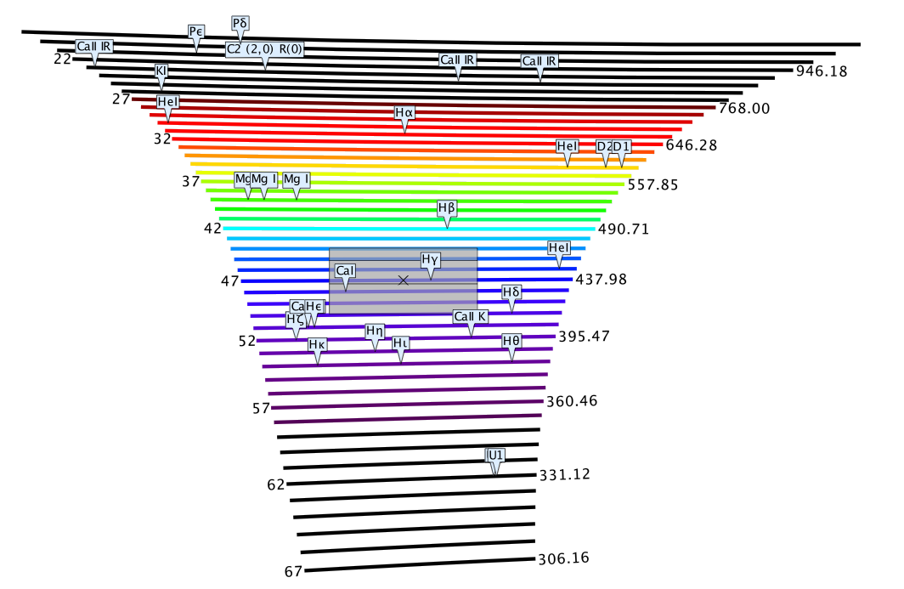

Slide 68
Normal vrs Grazing Incidence
At 300 Å, which instrument is most efficient, grazing or normal incidence ?
What are the defining points ?
The reflectivity of 300 Å photons at normal incidence is around 20 % whereas it is close to 100 % at grazing incidence !
So, grazing incidence is winning !
But due to aberrations, the F/number at grazing incidence is limited to around F/50, where as F/10 is OK at normal incidence.
Looks like an even match ! 50/10 is 5 and 100/20 is also 5.

Slide 69
But light collection is from the surface area of the grating, so related to (F/number)²
So, at least at 300 Å the normal incidence spectrometer is still a better choice !
Normal incidence has been used down to around 250 (or a little less) Å in Lund.

Slide 70
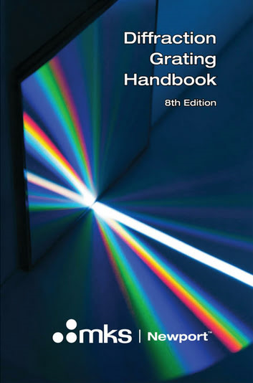
https://www.photonics.com/Products/Diffraction_Grating_Handbook/pr65173

