Slide 1
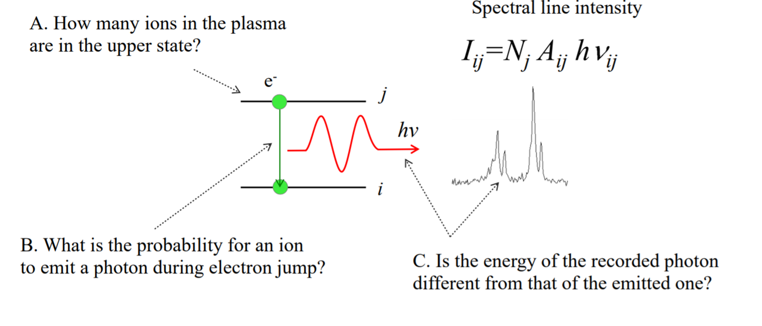
Before starting todays story on Atomic Structure， a short aside on spectral line intensities
There are quite many publications discussion line ratios and quite often disagreements with calculations.
The classic being for a line ratio in Ne-like ions

Slide 2
Line intensity depends on two parameters
The transition probability
The population of the upper level
In many cases theoreticians will argue that it is NOT the calculated transition probabilities that are in error
We have very few measured transition probabilities for highly charged ions, more for neutrals and single charged ions

Slide 3
Level populations are very difficult to understand
They depend very critically on what population mechanisms are at play in a given plasma
Basically the only population mechanism in an EBIT plasma is electron impact from the ground state, although some population via exciting already excited levels has been seen
Ions in fusion plasmas far from the neutral beam, if one is used for heating or beam-emission spectroscopic diagnostics, are similar to EBIT ions

Slide 4
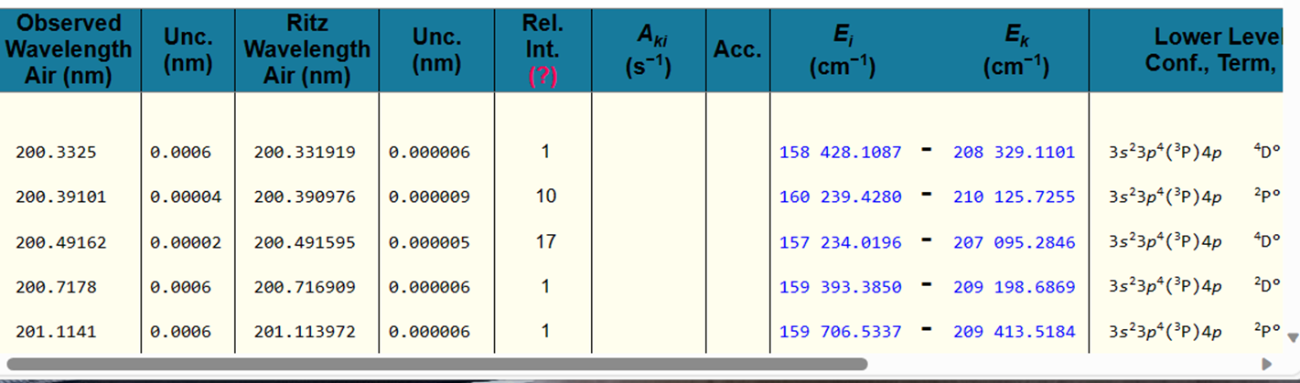
Ions in more dense plasmas show more excitation of highly excited levels through charge exchange
A very important consequence of this is that line intensities are different for different light sources
This means you must be very careful when using line intensities give in the NIST data tables. These intensities only have meaning if you are using the same kind of light source and SPECTROMETER

Slide 5
Now to an interesting point, raised a little on Tuesday
What is the transition probability ?
In total it must be the rate at which the population of a level is decreased, and ……
This depends on electron density, due to excitation/ionization
So we can write A(total) = A(radiative) + A(collision)

Slide 6
We then need a branching fraction to tell us how much population is lost in each channel … radiative or collision, which does not contribute to the line intensity
Branching fraction or ratio for the photon channel is：
B(rad) = A(rad)/(A(rad) + A(collision))
If the electron density is low, then B(rad) = 1
Usually good spectral lines for electron density diagnostics have A(rad) is pretty much the same as A(collision)
We will discuss an example for Be-like N later
Clearly, for forbidden transitions A(rad) is more sensitive to A(collision), even for low density plasmas

Slide 7
Atomic Structure
Roger Hutton （罗 杰）
A discipline with a long history and many great names involved. The classical picture of an atom goes back to Nils Bohr in Copenhagen in 1913. In one way he was trying to explain the Rydberg formula (1888) for the spectral lines in Hydrogen. Rydberg was based in Lund (Sweden), only around 40 kilometers away from Copenhagen (Denmark).

Slide 8
Quiz time
Which is the lowest energy level …
n = 0
n = 1
E_{n} ∝ z²/n²
Why is it so hard to calculate ZERO
experimentally the ground state has energy zero and the ionization potential is positive
Theoretically the ionization energy is zero while the binding energy is negative

Slide 9
Sources of Spectroscopic Data
A fairly comprehensive bibliographic review of compilations of data on atomic energy levels, wavelengths, transition probabilities, and spectral line shapes and shifts as available in 1991 is given in [39].
Access to most of the atomic spectroscopic databases
currently online is given by links at the Plasma Gate server [40]. Extensive data from NIST compilations of atomic wavelengths, energy levels, and transition probabilities are available from the Atomic Spectra Database (ASD) at the NIST site (see [13]). Section 16 includes additional references for wavelength tables.

Slide 10
The International System of Units (SI), edited by B.N. Taylor, NIST Spec. Publ. 330 (U.S. Government Printing Office, Washington, 1991), p. 29.
E.U. Condon and G.H. Shortley, The Theory of Atomic Spectra (Cambridge University Press, Cambridge, 1935, reprinted 1951).
R.D. Cowan, The Theory of Atomic Structure and Spectra (University of California Press, Berkeley, 1981).
H.A. Bethe and E.E. Salpeter, Quantum Mechanics of One- and Two-Electron Atoms (Plenum, New York, 1977).
B. Edlén, in Encyclopedia of Physics, edited by S. Flügge (Springer-Verlag, Berlin, 1964). Vol. 27.
H.N. Russell and F.A. Saunders, Astrophys. J. 61, 38 (1925).
C.W. Nielson and G.F. Koster, Spectroscopic Coefficients for the p ^{n}, d ^{n}, and f ^{n} Configurations (MIT Press, Cambridge, 1963).
W.C. Martin, R. Zalubas, and L. Hagan, Atomic Energy Levels - The Rare-Earth Elements, Natl. Stand. Ref. Data Ser., Natl. Bur. Stand. (U.S. Government Printing Office, Washington, 1978), No. 60.
A. de-Shalit and I. Talmi, Nuclear Shell Theory (Academic, New York, 1963).
H.N. Russell, A.G. Shenstone, and L.A. Turner, Phys. Rev. 33, 900 (1929).
R.F. Bacher and S. Goudsmit, Atomic Energy States (McGraw-Hill, New York, 1932).
C.E. Moore, Atomic Energy Levels, Natl. Stand. Ref. Data Ser., Natl. Bur. Stand. (U.S. Government Printing Office, Washington, 1971), No. 35.
W.C. Martin, A. Musgrove, S. Kotochigova, and J.E. Sansonetti, Ground Levels and Ionization Energies for the Neutral Atoms (version 1.3.1, 2003). This is one of several online NIST databases referred to in this chapter.

Slide 11
I got the above information from the following website
https://www.nist.gov/pml/atomic-spectroscopy-compendium-basic-ideas-notation-data-and-formulas/atomic-spectroscopy-9、
There are many links given at this web address, along with an article about very recent improvements made at the NIST EBIT following the arrival of an x-ray micro-calorimeter
https://www.nist.gov/news-events/news/2019/04/ebits-improved-x-ray-vision-promises-astronomical-insights

Slide 12

The Nordic countries and atomic physics/spectroscopy

Slide 13
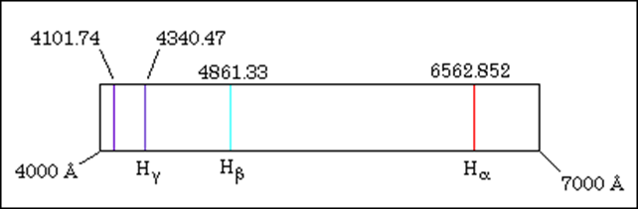
Hydrogen spectrum
In 1862, Anders Ångström，in Uppsala， discovered three lines and later on found the 4th line (the 4101.74 Å violet line). In fact the unit of distance, Å（10⁻¹⁰ m)，is named to commemorate the work of Ångström. By 1871, he measured all four wavelengths to a high degree of accuracy. In 1888 Rydberg gave a formula for predicting these spectral lines.

Slide 14
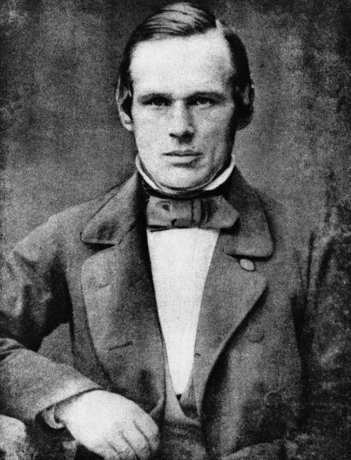
The most “famous” line in the hydrogen spectrum is Lyman alpha at 1215.6701 Å
Why did Ångström never this line ？？？？？
One question I was asked once （by a high ranking guy in the ITER diagnostic group), so I will ask you “Can you explain atomic structure using classical mechanics ?”
“Can you explain atomic structure using classical mechanics ?”

Slide 15
This is basically what Bohr did in 1913，But, he could not explain what the integers were
He could not explain either the fine details, for example that the n = 2 level actually consists of three levels. An explanation of this had to wait for the development of Quantum Mechanics by Schrodinger etc. explaining two of the levels.
Why only two ?
relativistic quantum mechanics (Quantum Electro Dynamics or QED) was needed for the third.

Slide 16
The spectrum of hydrogen has taught us a lot during history
First it led to the development of Quantum Mechanics
But, not even quantum mechanics could explain some troubles with hydrogen, leading to Quantum Electro Dynamics or QEDS

Slide 17
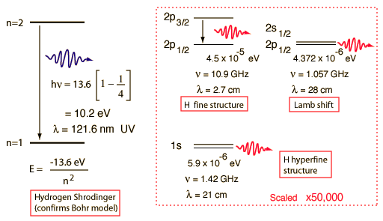

Slide 18
Still problems for 1 electron ions
GSI
Courtesy T. Stőhlker, GSI

Slide 19
Why is it so difficult to make higher charged ions ??
Gross energy level structure scales as Z² hence the binding energy of the 1s electron in Titanium (Z = 22) is about 500 times that of Hydrogen,
This would be like asking the worlds best high jumpers to stop messing around with 2 meters and jump one kilometer.
The energy scaling is not quite correct of course, otherwise there would be no fun,

Slide 20


Slide 21
Spectral Notation
H H I
He⁺ He II
Ar¹⁷⁺ Ar XVIII
Ti²¹⁺ Ti XXII
Ni²⁷⁺ Ni XXVIII
Kr³⁵⁺ Ke XXXVI
Zr³⁹⁺ Zr XL
Sn⁴⁹⁺ Sn L
100 = C, Century, from Roman word Centurian, and still used in English, in Cricket for example
What about negative numbers ??

Slide 22
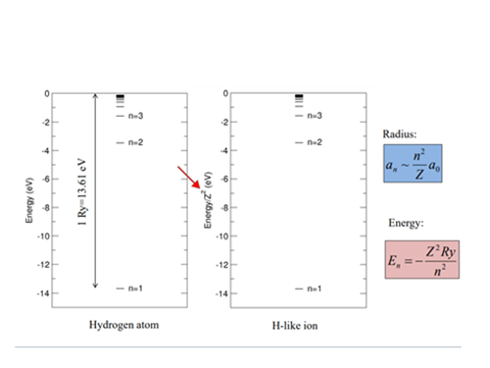
Energy scaling for H – like ions

Slide 23
Coupling schemes, how do electrons make friends and share properties
As an introduction to energy level coupling schemes we can consider the Helium atom. The ground state of Helium has two electrons, both in the n = 1 shell.
The allowed angular momentum states for the n = 1 shell is only l = 0, which we designate as “s” orbitals. Each electron can be designated with three quantum numbers, n, l and s (spin).

Slide 24
As both n and l are the same for the two 1s electrons then s must be different as fermions cannot occupy the same quantum space, i.e. they obey the Pauli exclusion principle
All 3 quantum numbers cannot be the same.
Therefore the two electrons must have different spins, 1/2 and -1/2, designated as spin up (↑) and spin down (↓). As the electrons are identical except for the spin this is usually represented as 1/2[（↑↓）+（↓↑）].
There is only one way this can be done and we call this a singlet term, designated as S. This is the only allowed term for the n =1 ground state and as s = 0 and j = 0, we designate this as ¹S₀, the “1” meaning singlet and the “0”is the total momentum, l + s (0 + 0).

Slide 25
The n = 2 shell can have l = 0 or 1. We are discussion the case where one electron has l = 1 here.
One of the first excited configurations is then the 1s2p. As the two electrons have different n and s, they may or may not have the same spin. Therefor there will be a term where both electrons have opposite spin, as above, and this we designate as the ¹P₁ state as l + s is now 1 + 0 for the one electron in the p orbital, and only 1 way to do this.
As the other quantum numbers are different the spins can be the same , i.e. either both up or both down. There are three ways this can be done: (↑↑)， (↓ ↓), 1/2[ (↑↑) + (↓↓)]. This gives us the three states of what we call the ³P, i.e. ³P₀, ³P₁ and ³P₂.

Slide 26
The above discussion, leading the Russel-Saunders, or LS, coupling scheme works under the condition that the electron-electron (+ spin-orbit) interaction is relatively strong compared to the electron-nucleus interaction. We can also say that the electron correlation is strong here. In this case the orbital angular momenta of each electron are (vector) added to give a total orbital angular momentum, L, and similarly for the spins of each electron to give S, then L and S are added to give the total momentum J, hence we call this LS coupling.
As we move towards higher Z members of the He isoelectronic sequence (for example) the electron-nuclear interaction becomes more dominant and the electrons become more independent.

Slide 27
In this case the orbital angular momentum and spin of each electron are added independently to give a j, the j’s are then (vector) added to give a total J. This is called jj coupling and gives a very different energy level scheme, as illustrated in figure LS-jj.
The fact that the electrons become more independent of each other and more dependent on the nuclear-charge as Z increases may have very interesting and important implications for the spectra.
Also indicating that electron correlation will play a less important role in calculations of atomic structure.

Slide 28
As we move towards higher Z members of the He isoelectronic sequence (for example) the electron-nuclear interaction becomes more dominant and the electrons become more independent.
In this case the orbital angular momentum and spin of each electron are added independently to give a j, the j’s are then (vector) added to give a total J. This is called jj coupling and gives a very different energy level scheme, as illustrated in figure LS-jj.
JJ coupling may have an interesting effect on spectral appearance, we will discuss this later

Slide 29
Often for our own convenience we give a level an LS name, even if the level is clearly NOT LS coupled
An example is the lowest excited configuration in He-like ions, the 1s2p. There are four levels, as we said, belonging to this configuration, ¹P₁ and ³P_{0,1,2}
Even by Fe XXV these four levels have broken into two jj coupled pairs. This is important to remember as it becomes more difficult to talk about the spin-forbidden decay of the ³P₁. For the similar transition in Fe XVII (Ne-like) seen in astrophysical plasmas like the solar corona, this transition can not really be called forbidden

Slide 30
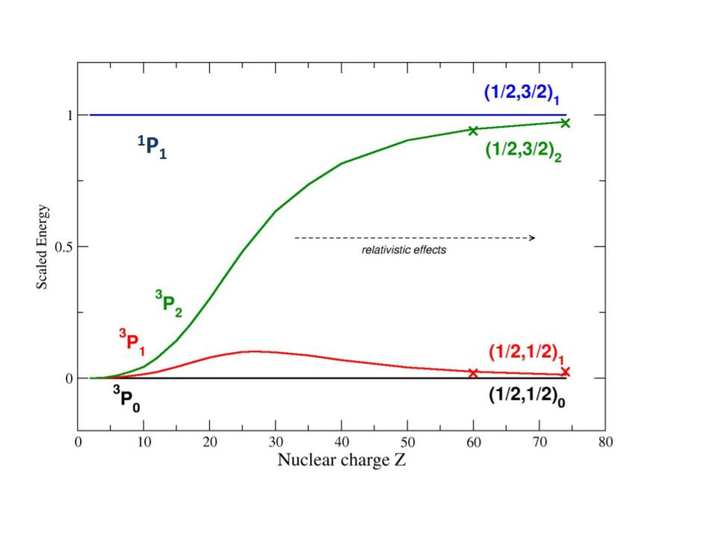
Development of the 4 levels of the1s2p configuration in He-like ions （for example）

Slide 31
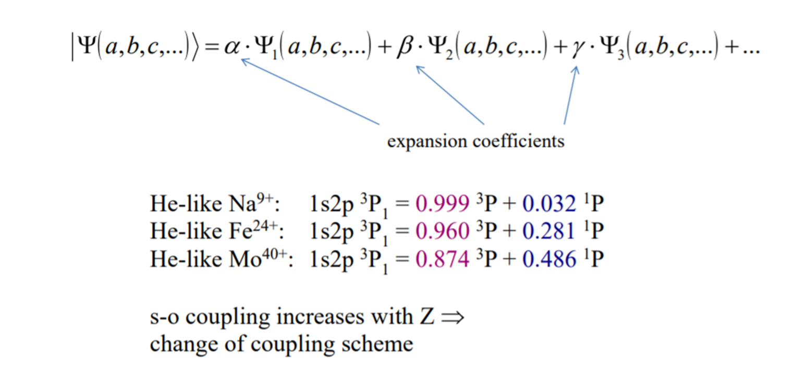
Wave functions showing the energy level structure changing along the sequence

Slide 32
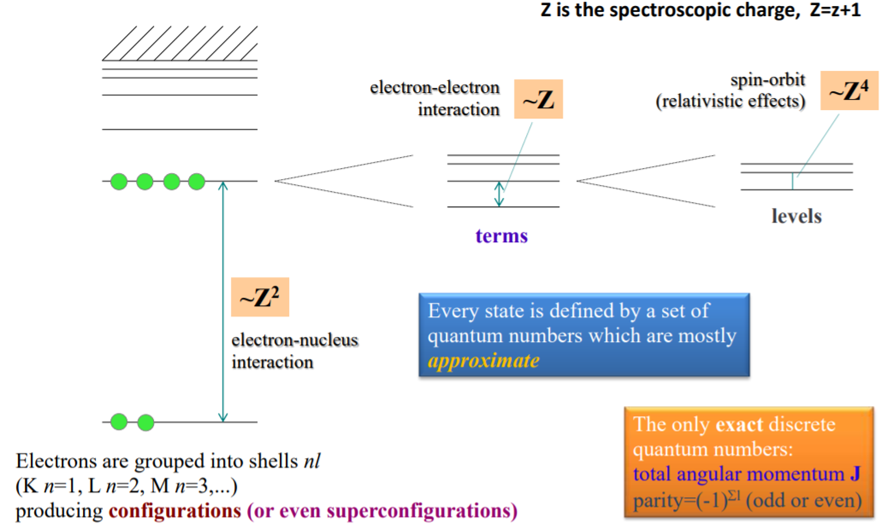
The different contributions to energy levels and scaling

Slide 33
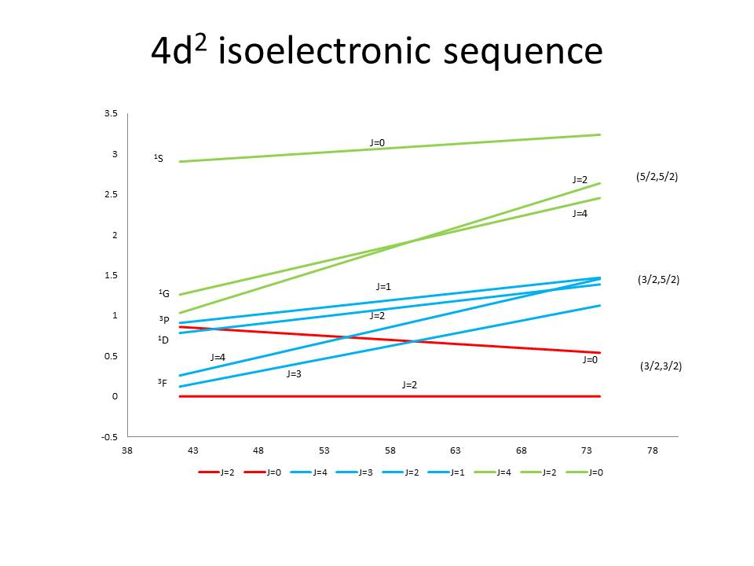
Transition from LS to jj coupling
The development of the energy levels of the ground configuration of Fe-like ions along the sequence. From Z around 62-63 the levels become jj coupled and this actually plays an important role in the final appearance of the spectrum, this will be discussed later.

Slide 34
One of the most useful ideas in atomic structure is that of scaling laws. Scaling laws/rules have been established for almost all atomic parameters, energy levels, oscillator strengths etc.
A very good introduction to these ideas is given by Alan Hibbert in the book chapter called “trends chap” in the reference file.
Below are just a few examples.
The energy between configurations scales as Z² whereas the fine structure energy scales as Z⁴. This can (and does) mean that sometimes the fine structure energy is bigger than the energy between two configurations, as for the 3s²3p and 3s3p² for high Z Al-like ions. In such cases the level assignment is never easy.

Slide 35
Examples of scaling rules, from te arcitle by Alan Hibbert
We have already seen that we can write energies of atomic systems in the form
E = Z² (E₀ + 1/Z xE1 + 1/Z²xE2 + 1/Z³xE3 + · · · )
where E₀ is the sum of the hydrogen energies of the orbitals in the main configuration.
Hence transition energies have a Z-dependence dominated by
Z² if the n-values of the orbitals are different (e.g. 1s² − 1s2p He-like)
Z if the n-values of the orbitals are the same (e.g. 1s²2s² − 1s ²2s2p) （Be-like)

Slide 36
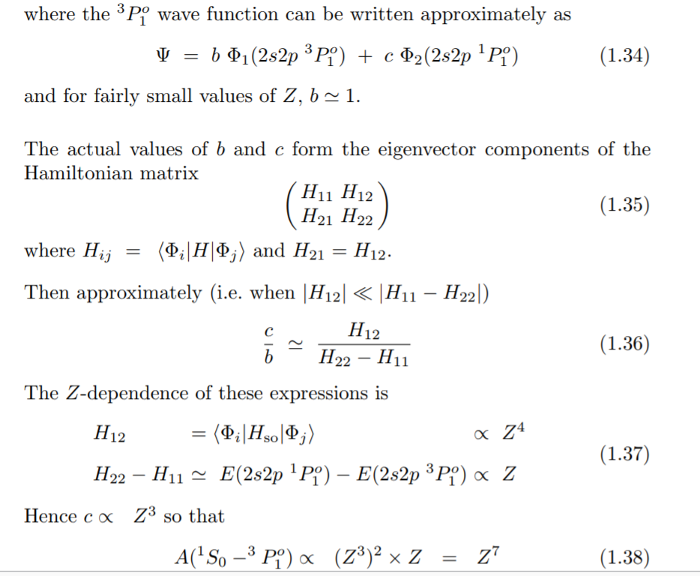
The below section of Alan’s article tells us a lot !

Slide 37
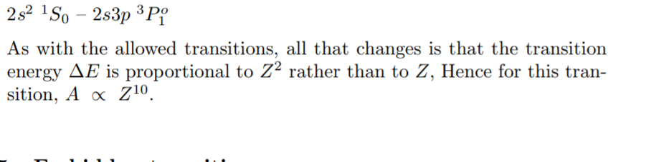
Transition rate for the 2s² ¹S₀ – 2s3p ³P₁ i.e. Δn = 1.

Slide 38
This figure first appeared around 1986, produced by W. Martin at NBS (currently known as NIST). Low Z elements and elements of interest to astronomy are quite well understood and also a few is-electronic sequences, such as H-, He-, Li-, Na-, Cu-, and Ag-like. But a lot of elements and charge states have basically no data.

Slide 39
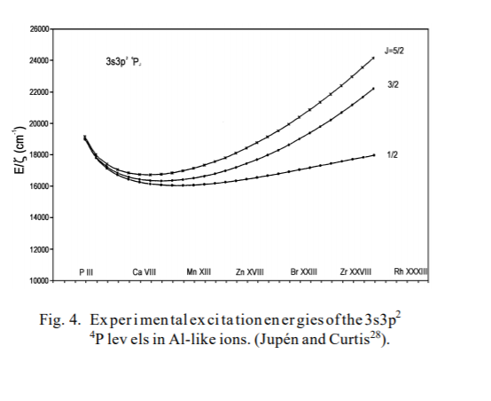
Development of energy levels along an iso-electronic sequence

Slide 40
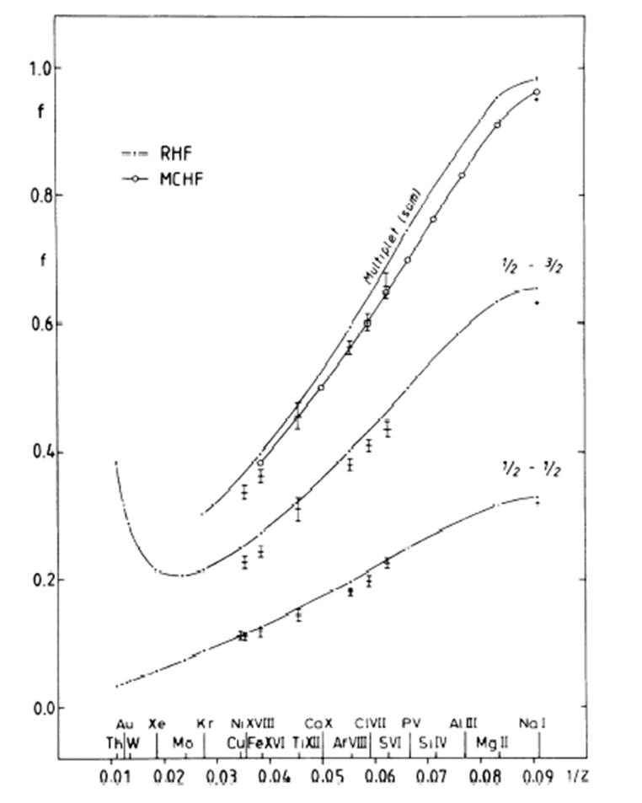
Z dependence of the oscillator strength for the Na-like resonance transitions along the sequence

Slide 41
Forbidden Transitions
What are these ?
Most famous are the spin-forbidden transitions or inter-combination lines
e.g. the 2s² ¹S₀ – 2s2p ³P₁ transition in Be-like ions
We would like to argue that such transitions are NOT forbidden, the above transition in Be-like ions is an E1 transition

Slide 42
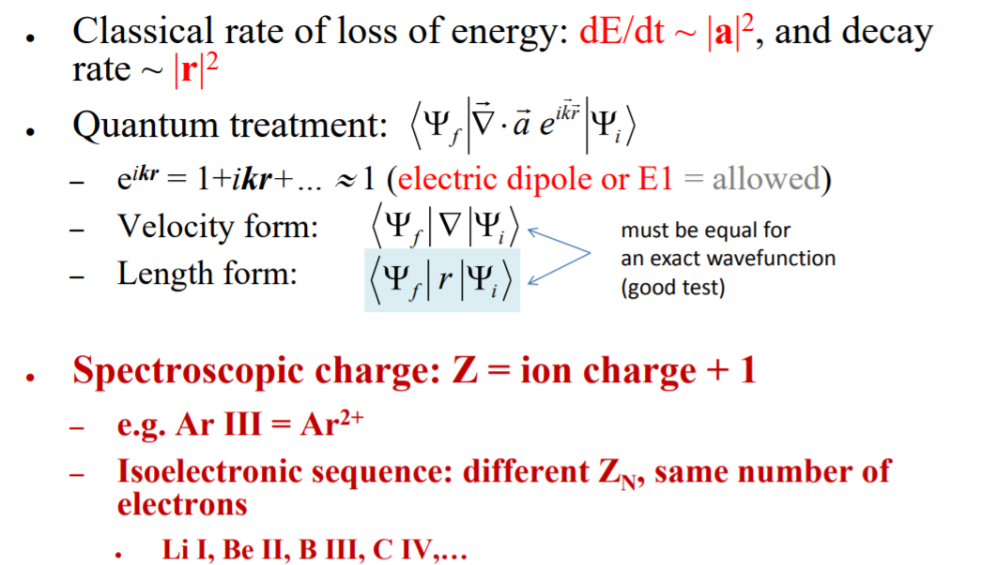
Transition probabilities

Slide 43
Allowed and forbidden transitions, E1, M1, E2 etc.
E1 or electric dipole, allowed, transitions
E1 transitions between ground state levels and levels in the first excited configurations are called resonance transitions
Each class of transitions have their own set of trnsition rules
For E1
Parity must change
Spin should not change as the coulomb operator has no spin involved and
Δj = 0, +- 1, but never j = 0 to j = 0, totally forbidden

Slide 44
All transitions that are NOT E1, i.e. not from the first term in the transition operator expansion, are forbidden.
The first forbidden transition is an M1, or magnetic dipole
The transition rules are different to E1 transitions
No change of parity, a spin change is allowed and again ΔJ = 0 or +_ 1, J = 0 to J== 0 is OK
AND, very important, the rate is very easy to calculate

Slide 45
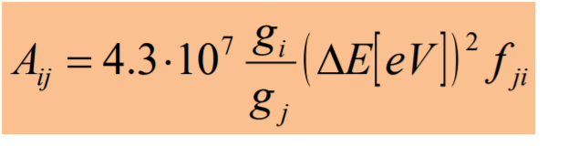
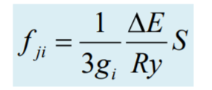
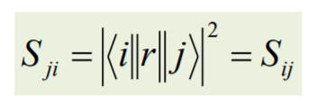
For M1 transitions, S does not depend on the wave function and is hence very easy to calculate.
If we use experimental values for ΔE then the M1 rate is known very well

Slide 46
The M1 case is very unique but other forbidden transitions are also not so difficult to deal with
Just a different operator, between the two wave functions in the matix element
So, bottom line, do not be worried by forbidden transitions. Many can be seen and used in diagnostics in fusion plasma spectra.
What are difficult to deal with are transitions we like to call un-expected. “We” being Tomas Brage and myself.

Slide 47
Unexpected transitions
A good example of what we mean here is:
1s² ¹S₀ - 1s2p ³P₁ transition in like ions
Why is this unexpected ?
It full fills the properties of an E1 transition, except ΔS is not zero
Lets look again at the wave function for this ³P₁ level

Slide 48
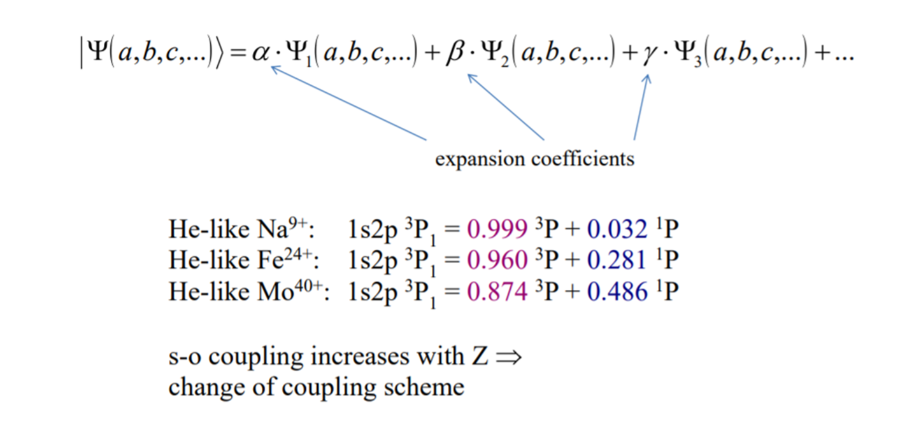
The contribution of the ¹P₁ level increases along the sequence, and this “mixing” means that the ³P1 level does in fact decay as an E1 transition

Slide 49
Such mixings are notoriously difficult to calculate
Hence unexpected transitions, ones that are caused by a mixing of wave functions, are much more difficult to deal with than forbidden transitions
After many years of comparing experimental and calculated rates for such transitions, spin-forbidden or inter-combination lines, there is at least some confidence in the calculational procedures used
How to measure transition rates for highly charged ions ?

Slide 50
A very interesting use of the old technique named Beam-foil Spectroscopy
We measured the lifetime of the 2p⁶3p ²P_{1/2} and ²P_{3/2} levels in Na-like ions.
Basically expecting our results to agree with theory

Slide 51
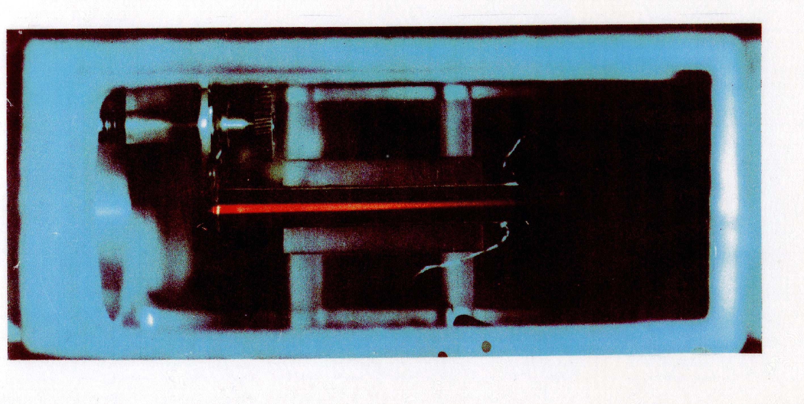
The technique of Beam-Foil Spectroscopy
Developed independently by Baskin in Tucson (Arizona) and Kay (Manchester) in around 1968 and went on to revolutionize the world of highly charged ion physics, sadly no where to be found now
After a full cascade analysis of the data. The lifetimes did NOT agree with any calculation. At that time, all calculations (no matter what code was used) gave the same result

Slide 52
After a full cascade analysis of the data. The lifetimes did NOT agree with any calculation. At that time, all calculations (no matter what code was used) gave the same result
Why ??
Well, all calculations missed the importance of core-polarization on level lifetimes !

Slide 53
Finally I will discuss problems associated with thinking Bohr-like. What do I mean by this? Many researchers, especially in high-energy atomic-physics experiments really do think of electrons as “balls”. That this is not true can be illustrated using two examples.
Let’s think about the difference between Helium, He, and Beryllium, Be. He has a 1s2 1S0 as the ground state level and Be has 1s22s2 1S0, Be is poisonous but He is not !!!!
why? ??

Slide 54
The 1s² ¹S₀ of He is a closed-shell arrangement and there is no mixing with other configurations.
On the other hand, the 1s²2s² ¹S₀ of Be is heavily mixed with the 1s²2p² ¹S₀ actually making the ground state energy of Be I very hard to calculate.
The 2p² is highly reactive and hence Be is poisonous and He is not.

Slide 55
The 2nd example is an interesting configuration in Lithium, Li, (or Li-like ions).
The ground state of Li is 1s²2s ²S_{1/2}.
However, through either inner shell excitation, inner shell ionization of Be, or a process called di-electronic recombination the interesting configuration of 1s2s² ²S_{1/2} can be formed.
This level can decay to the 1s²2p ²P levels and many like to call this a 1 photon 2 electron (1P2E) transition.
In fact it is caused by the same configuration interaction as discussed above for He and Be.

Slide 56
There are a number of well know strong configurations in atomic structure such as the 2s² and 2p², another is the 3p² and 3s3d.
Basically, if there are two, or more, electrons outside of a closed shell, then the electrons cannot be treated as independent particles, like in Bohr’s model.
Even if the electrons seem very far apart, for example 2p⁶3snl where the 2p⁶ is a closed shell and n is relatively large, 8 or 9 for example.
There will always be some configuration that will interfere through interaction, for example a 3pn’l’ configuration, where n’ is less than n and the energies of the two configurations are close

Slide 57
Does the coupling scheme have any physical significance ?

Slide 58
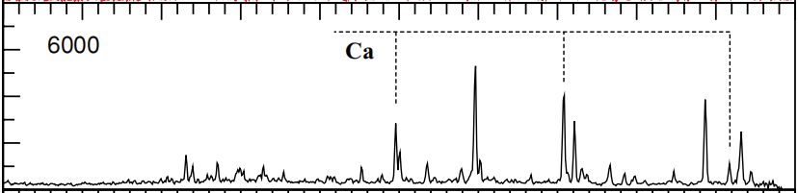
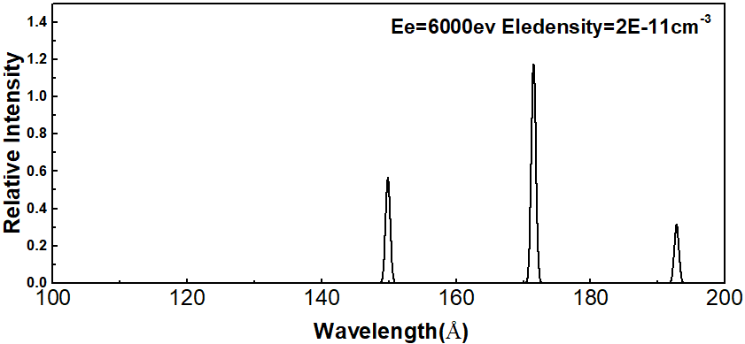
Spectral lines from transitions within the ground configuration of
Ca-like W, W⁵⁴⁺
Top spectrum is from the NIST EBIT laboratory and the bottom is a simulated spectrum using a so-called collision radiative model.
As far as we could tell for W²⁶⁺ our simple 2j+1 model is just as good as the CR model, but a whole lot simpler.

Slide 59
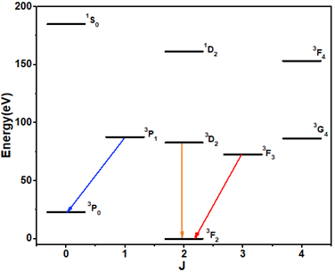
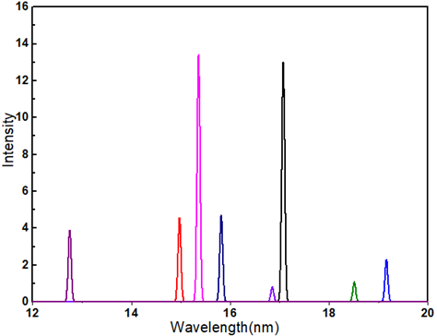
What about our 2J+1 model for W⁵⁴⁺ ?
The three observed lines are shown in the figure of the energy level structure. BUT, our simple 2J+1 model predicts an extra 5 lines. SO, BIG problem
Then we were a little clever, or maybe we were silly before.
We drew the energy level diagram using a thing called jj coupling.

Slide 60
JJ coupling
With increasing nuclear charge the electrons become more independent and couple their own moments first. Nuclear- electron interaction dominates.
LS or Russel Saunders coupling
Couple the electrons spins to give a total spin, S, then couple the orbital angular momenta to give a total L . Then couple the S and L to give a total J

Slide 61
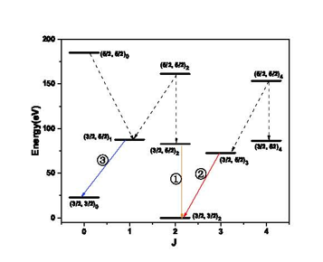
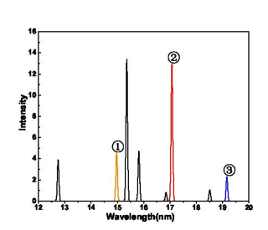

Slide 62
Comparison of our W⁵⁴⁺ data with that of D and D
Three levels of the type [2/3, 5/2]
Level population
Us D&D Statistical MFGu
J = 1 0.72 2.73 3 1
2 1.22 2.27 5 1.8
3 1.25 2.27 7 2.2
Conclusions, be very careful about who runs the CR model

Slide 63
BUT .. WHY are the (5/2, 5?2) levels not populated ??
We have found that the Fe-like (3d⁸), i.e. two 3d holes behaves the same
3d⁸ is just the inverse of 3d², i.e. the 5/2,5/2 levels are the
lowest in energy
Also, recently we found data from the Berlin EBIT for 4d² and the same population is seen, or the lack of population
This lack of population is predicted by CRM for a mono-energetic electron beam, but what is the underlying physics ??

Slide 64
Thank you for your attention today ！！！
QUESTIONS ？？？？

