Slide 1
Quantum interference, and the Solar Corona Magnetic Field
Roger Hutton (罗杰)
Department of Astronomy, Beijing Normal University, China
Department of Physics, Lund University, Sweden

Slide 2
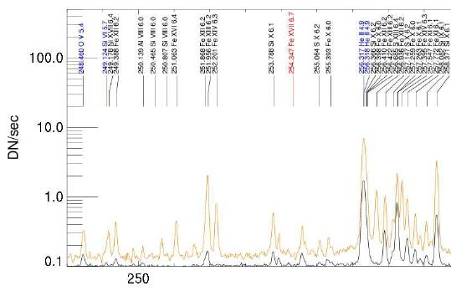
HINODE spectrum around the region of interest
Many spectral lines, the trick is to know which lines tell us more than others

Slide 3
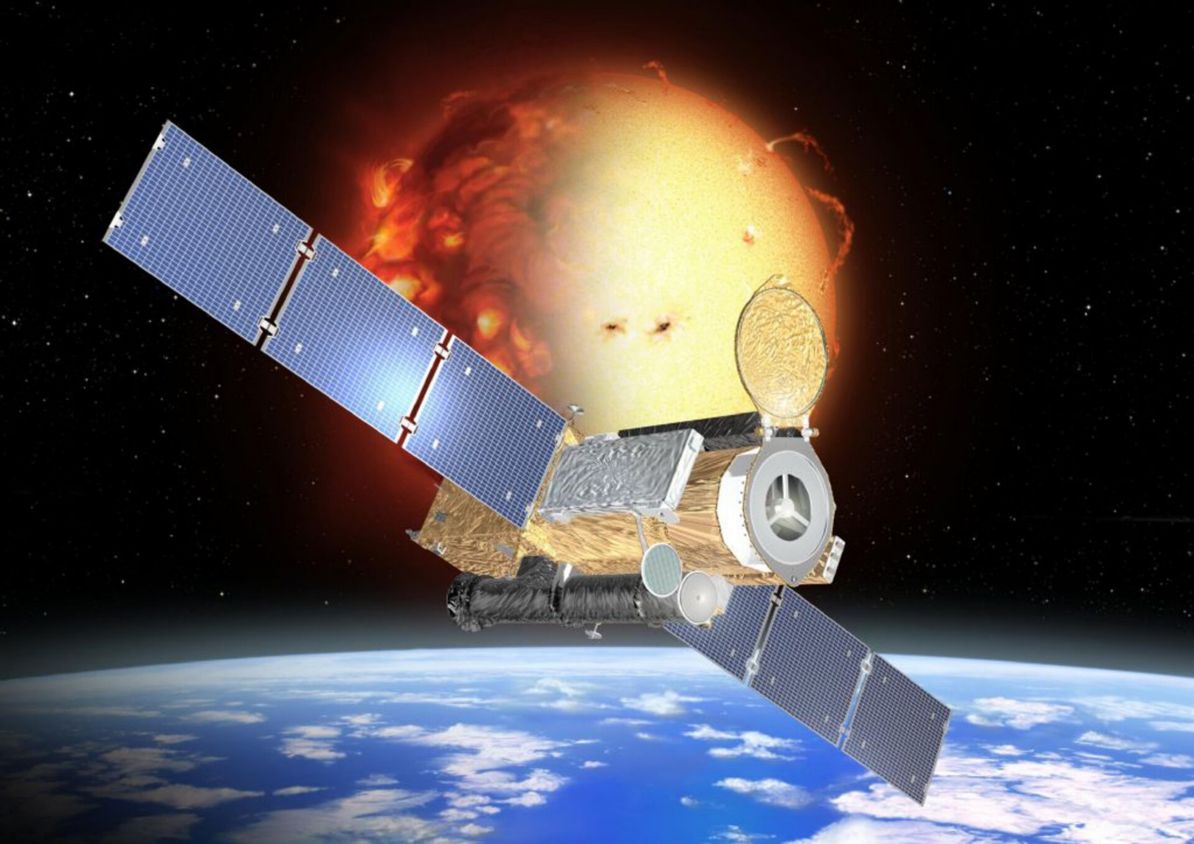
Solar-B （HINODE）– a “new” solar mission to study the dynamic Sun. One instrument is the EIS high resolution soft x ray spectrometer
https://www.nasa.gov/mission_pages/hinode/index.html

Slide 4
Collaborators on this work:
Wenxian Li, National Observatory, Beijing, China
Tomas Brage, University of Lund, Sweden
Phil Judge, High Altitude Observatory, Bolder (USA)
Meichun Li, University of Huizhou，China
JiLong Peng, Chinese Academy of Space Instrumentation, China
Enrico Landi, University of Michigan, USA

Slide 5
Overview
Something about the Sun
Quantum interference
Electron Beam Ion Traps
The solar corona magnetic field

Slide 6
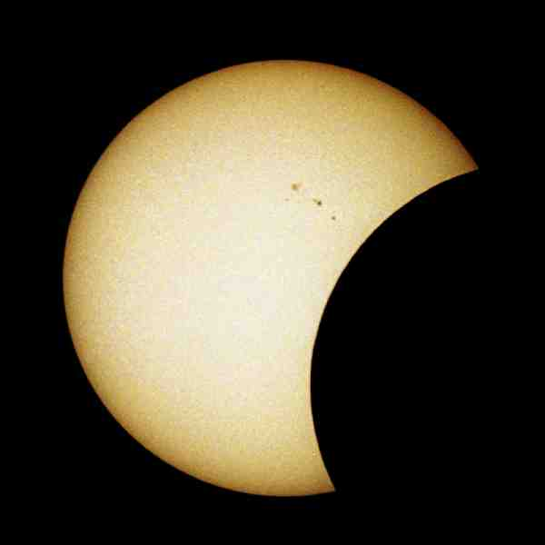
What is this ????

Slide 7
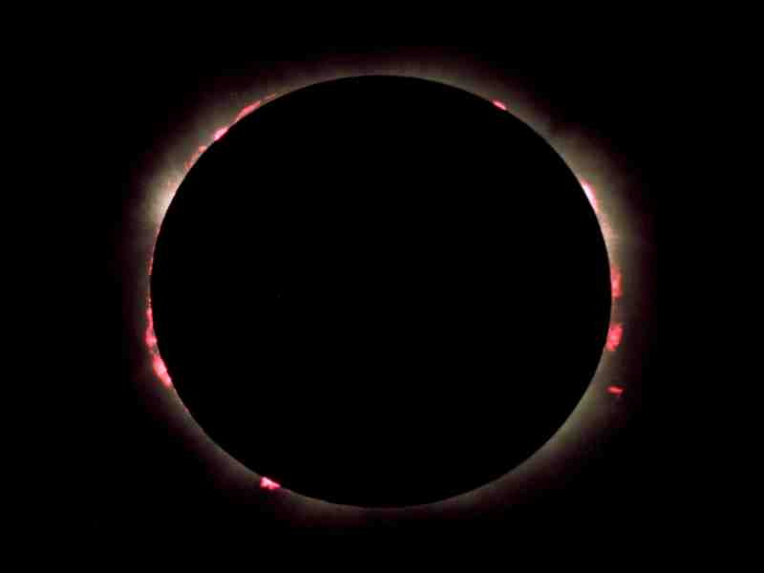
Completion of the last slide
The Solar Corona, much hotter and less dense than the Solar surface
The temperate was fond to be round 300 times hotter by Bengt Edlen in the 1940’s
The Solar Eclipse pictures are courtesy of from Robin Barnsley (ITER)

Slide 8
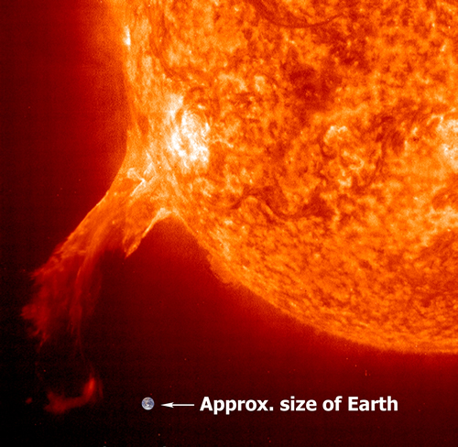
To set the stage …. And, to get an idea of the size of things
How much energy is released ??

Slide 9

We would like a warning if something like this were coming … wouldn’t we ?
Courtesy of Dr. Who, BBC

Slide 10
Welcome to the world of quantum states!
Ions have specific energy states.
Most often, they are in their lowest – ground state.

Slide 11
Ions get excited to higher lying energy levels.

Slide 12
Ions get excited to higher lying energy levels.
Sometimes they can decay to lower states.

Slide 13
Ions get excited to higher levels.
Sometimes they can decay to lower states by emitting photons.

Slide 14
Other excited states have different properties

Slide 15
Other states have different properties
No decay is allowed – the atom gets stuck!
A metastable level

Slide 16
Other states have different properties
No decay is allowed – the atom get stuck!
No photons sent out.

Slide 17
But a magnetic field can change the picture.

Slide 18
But a magnetic field can change the picture.
The two states interchange properties.

Slide 19
But a magnetic field can change the picture.
The two states interchange properties.

Slide 20
But a magnetic field can change the picture.
The two states interchange properties.

Slide 21
But a magnetic field can change the picture.
The two states interchange properties.

Slide 22
But a magnetic field can change the picture.
The two states interchange properties.

Slide 23
But a magnetic field can change the picture.
The two states interchange properties.

Slide 24
But a magnetic field can change the picture.
The two states interchange properties.

Slide 25
But a magnetic field can change the picture.
The two states interchange properties.
The atom is unstuck

Slide 26
But a magnetic field can change the picture.
The two states interchange properties.
The atom is unstuck
..... And photons are sent out from both states.
Clearly the number of red photons will depend on the strength of the magnetic field and on how close the degeneracy is

Slide 27
What we want to do now is connect this interesting quantum interference with something to do with the Sun, and in particular, with the Solar Corona
An interesting question then is how can we study the Solar Corona in our laboratory ?
We use a device known as an Electron Beam Ion Trap, EBIT, which creates a “plasma” with close to similar properties as the Solar Corona

Slide 28
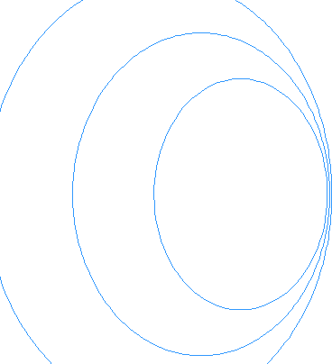
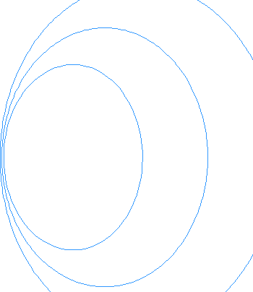

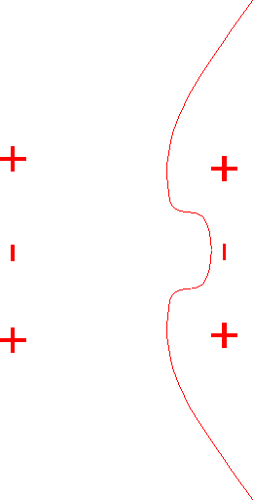








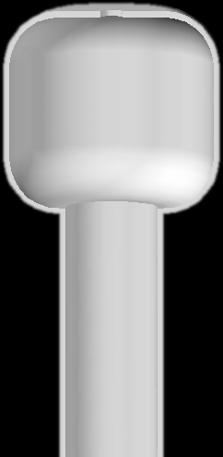
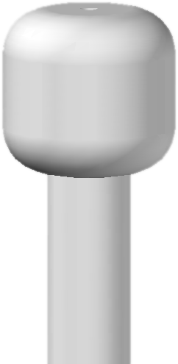
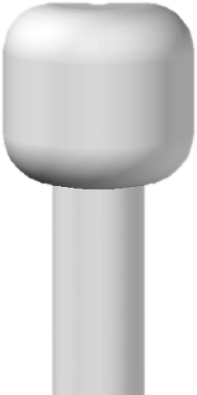





Slide 29
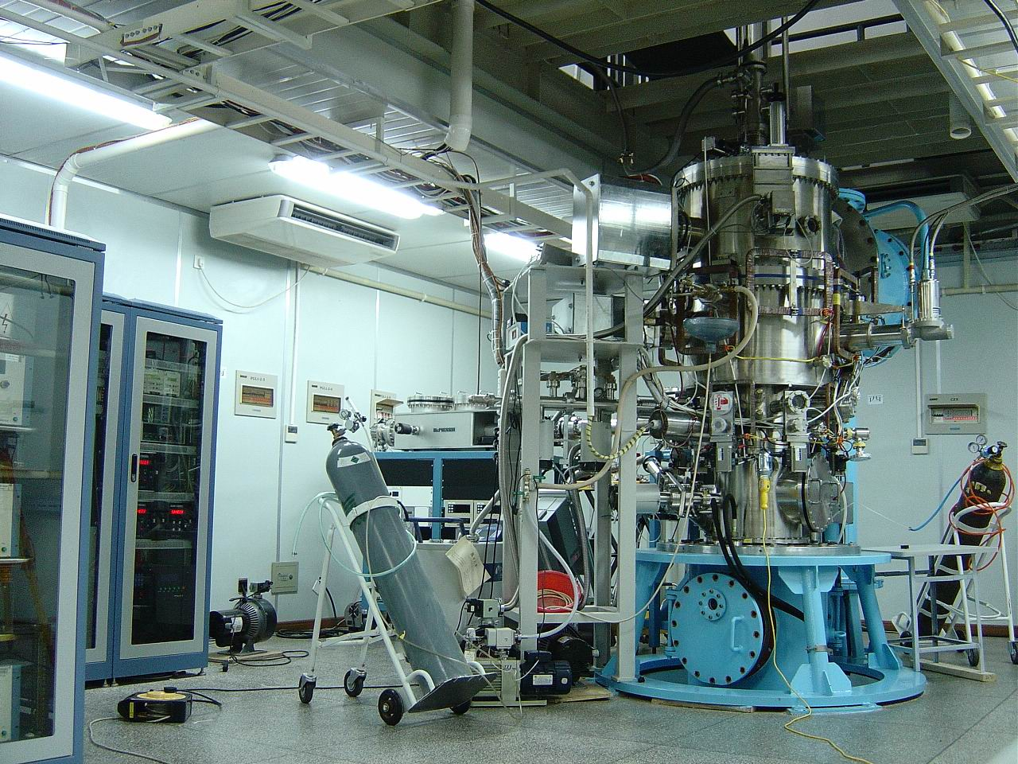
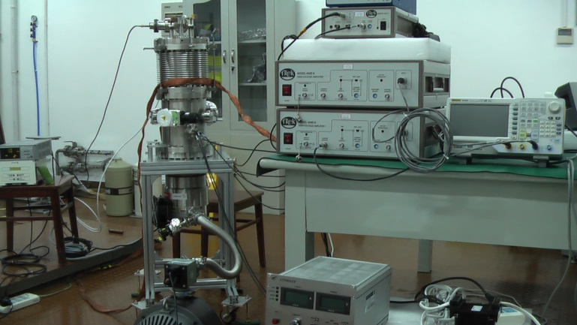
The Shanghai Electron Beam Ion Trap laboratory has 3 or 4 EBITs
The original
High temperature superconducting
Solar flare EBIT

Slide 30
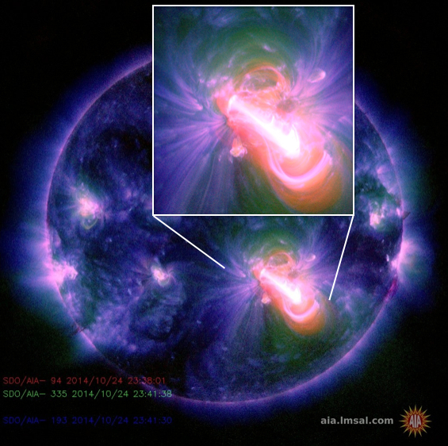
Solar Corona Magnetic Field

Slide 31
Surprising …
There were NO space based and direct ways to measure the strength of the Solar Corona magnetic field !
Through studies of the atomic structure of highly charged ions we recently proposed a method to measure this magnetic field strength

Slide 32
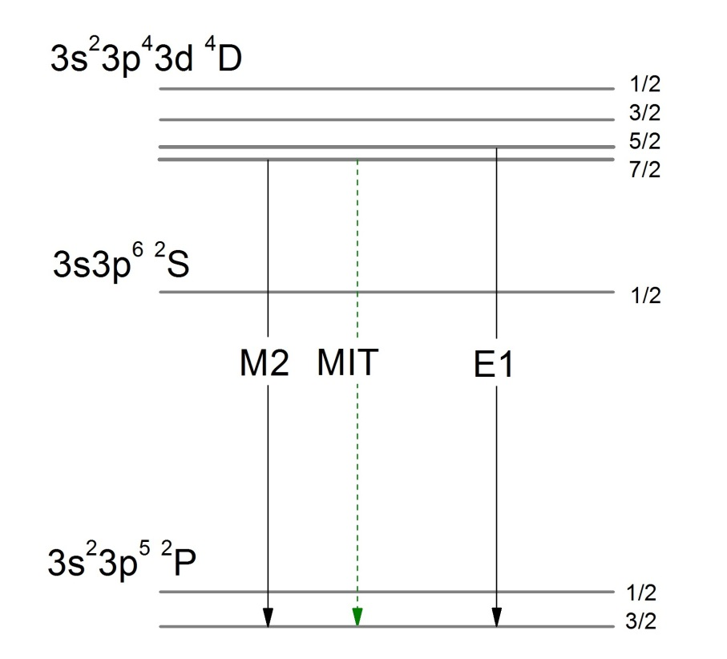
Accidental Degeneracy of Quantum States in the Fe⁹⁺ Ion, quantum interference leading to a magnetic induced transition, MIT.
The interfering levels are the ⁴D_{5/2} (yellow) and the ⁴D_{7/2} (red) and the interference is caused by an external magnetic field. The strength of the interference depends on the closeness of the degeneracy and the magnetic field strength
Astrophysical Journal, Volume 807, 69, (2015)

Slide 33
The fine structure energy between the ⁴D_{5/2} and ⁴D_{7/2} levels for Cl-like (3p⁵) ions from our MCDF calculations
Very lucky that the minimum fine structure energy is for Cl-like Fe and that this ion is abundant in the solar corona

Slide 34
﻿MIT(Intensity) ≈ B²/(λ³x(ΔE)²)
Also, and more useful for modelling ≈ A(E1)x(B/ΔE)²
We really need to know ΔE
How to measure this ???
The most straight forward would be to observe the two spectral lines
For a ΔE of 5 cm⁻¹, the required spectrometer resolution: 80000 (difficult), needs a 10 meter long spectrometer
An indirect method

Slide 35
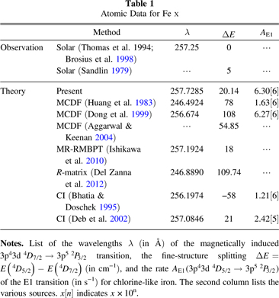
.
The Quest for ΔE (closeness of the degeneracy)
The sensitivity of our method depends very much on the absolute value of ΔE
ΔE ranges, from theory, between -58 to 109 cm⁻¹
cm⁻¹ is a unit of energy and 1 cm⁻¹ = 1/8056 eV
We need a measurement

Slide 36
Another idea to get the fine structure energy
The ratio of the blended 4-1 and 5-1 lines with the 6-1 line is also sensitive to the external magnetic field

Slide 37
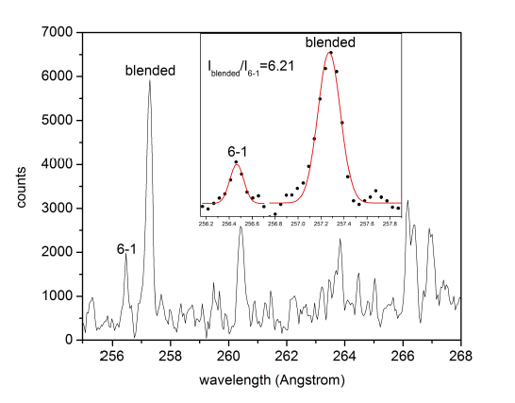
Using the known magnetic field of our EBIT, we could extract the previously, experimetally, unknown fine structure energy difference between the ⁴D_{7/2} and ⁴D_{5/2} levels
obtained 3.7±3.7 cm⁻¹
Indicates the idea will work, but too large uncertainty
Publish in the Astrophysical Journal

Slide 38
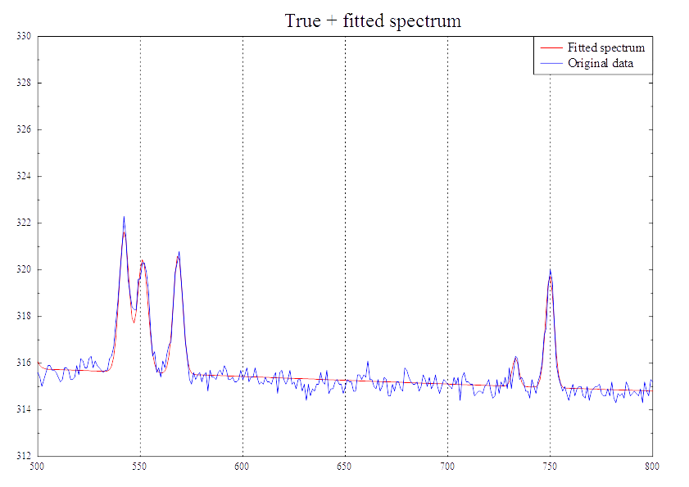
HINODE vrs EBIT, spectra around the region of inerest

Slide 39
Our original idea what to use the blended 4-1 and 5-1 line in a ratio with the 6-1 line to get the magnetic field, BUT, the 6-1 line is blended in corona spectra by a strong He line, so this is not possible
The 7-1 line from the same term is to weak and, basically lost in the noise, and hence, not useful
At this point, back in 2016, we though the method was very interesting, but not possible to use
There was a lull in progress between 2016 and 2019

Slide 40
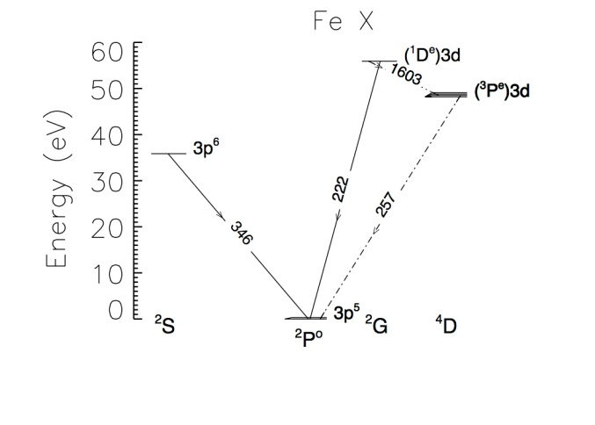
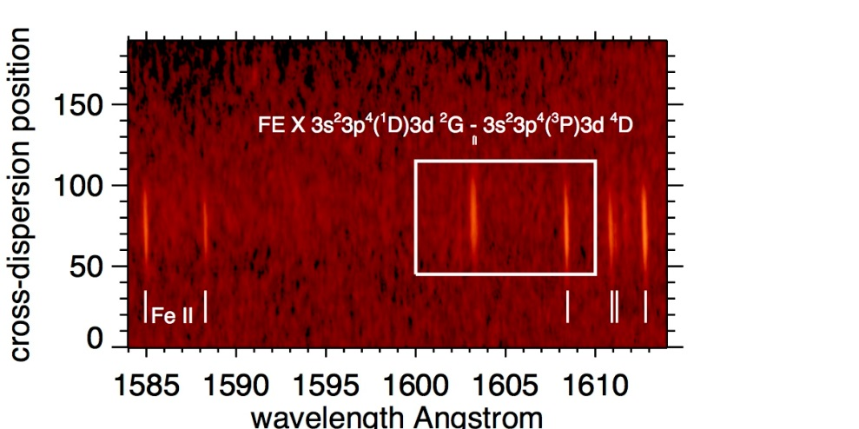
Some work in 2016 on the fine structure energy
Using spectra obtained from a spectrometer flown on SkyLab in the 1970’s we have now got a better value for the fine structure of 3.5 +- 2.7 cm⁻¹
3p⁴(¹D)3d ²G_{7/2} to the two lower ⁴D levels, around 1603 Å
Unfortunately we need even high accuracy for this fine structure energy to give good accuracy for the active corona magnetic field.

Slide 41

We also needed a way to measure the electron density. The ⁴D_{7/2} level is metastable, and has a long enough life time to be sensitive to de-excitation by electron impact
After some time of little activity …
There are other energy levels in the 3p⁴3d electronic configuration

Slide 42
Ratios of these lines with the 4-1+5-1 blended line could give the magnetic field strength … and
also a ratio of two other lines from levels in the 3p⁴3d configuration is sensitive to electron density
What’s more, data is available from HINODE
Finally, the CHIANTI atomic structure data base can be used to extract the magnetic field from the measured spectra
The game was back on !!

Slide 43
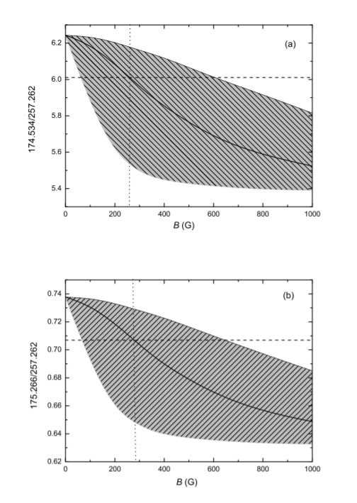
The first estimate of the corona magnetic field strength came out as an ApJ Letter in 2020
Simulated intensity ratio (blck line) of (a) 174.534/257.262 and (b) 175.266/257.262 as a function of the magnetic field in the AR area.
The grey shaded area shows the uncertainty caused by the uncertainty in the ∆E-parameter.
The horizontal dashed line is the line ratio measured from HINODE. The vertical dotted line shows our estimated magnetic strength.

Slide 44
This result inspired Enrico Landi and a new measurement was made of the fine structure using the same spectral feature introduced by Phil Judge but using a different spectrometer
This measurement, by Landi et al., had one extra spectral line compared to Judge, so he could measure the instrument line width of the spectrometer.
This meant 1 less parameter to fit to obtain the fine structure energy
This result gave 2.2 +- 0.5 cm⁻¹, so, almost 4 times better uncertainty, still the best, but needs improving
E. Landi et al., Astrophysical Journal

Slide 45
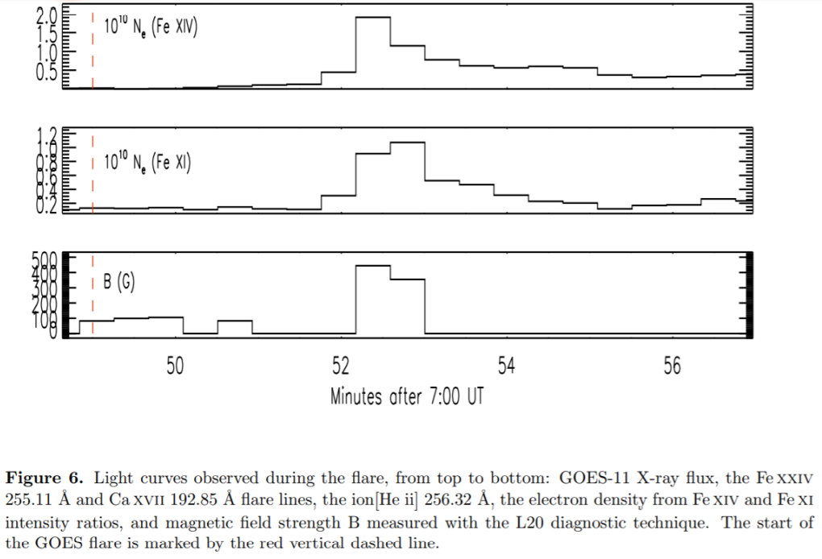
Landi et al, astrophysical journal (2021)

Slide 46
This work has been published in more than scientific journals !
It made a Swedish evening news paper (Expresen) “Breakthrough method for predicting solar storms”
Also a “popular science article for the HINODE “nuggets” series: “Hinode/EIS measurements of active region magnetic fields”
A recent paper described an MIT in Sr IV and the original MIT is from the spectrum of Ne-like Ar (needs a high magnetic field of the order of Tesla)

Slide 47
The importance of this new diagnostic technique (MIT) lies in two basic facts:
the coronal magnetic field is probably the most important unmeasured quantity in coronal physics, as it is at the heart of the processes regulating Space Weather and the properties of the solar corona
2) this technique can be applied to the existing
EIS archive spanning from 2007 to 2020, including more than one full solar cycle and
covering a large number of active regions, flares, and even coronal mass ejections.

Slide 48
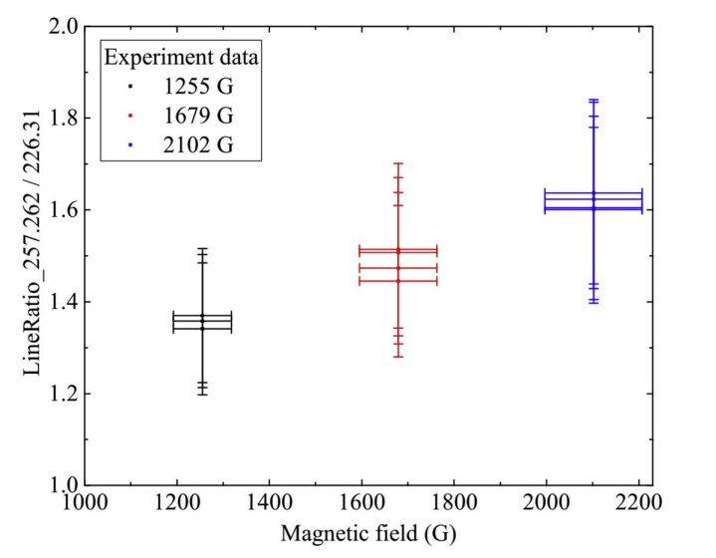
Laboratory studies of the line ratios are very difficult as most EBITs operate with fields around 0.1 T or more, higher than corona fields
Xu et al Astrophysical Journal 2023

Slide 49
Summary
1) Importance of the solar corona magnetic field and that this is a difficult quantity to measure
2) How quantum interference in atomic structure can give us a method to measure the coronal field strength through a Magnetic Induced Transition

Slide 50
3) Laboratory and astrophysical measurements of relevant atomic data for the ion Fe⁹⁺. The laboratory work is down using a device known as an electron beam ion trap
4) Use of the magnetic induced transition in the spectrum of Fe X to monitor the solar corona magnetic field strength as a function of time during a solar flare

Slide 51
Thank you for your attention
Questions ?????

Slide 52
What about fusion plasma ?!?!
Let’s go back to the simple formula giving the MIT rate:
﻿MIT(Intensity/rate) ≈ A(E1)x(B/ΔE)²
The chance to see an MIT depends on two things,
the magnetic field strength and
(b) the electron density. The 4D7/2 level is after all metastable.
As ΔE is fixed there is a competition between the field and the electron density.

Slide 53
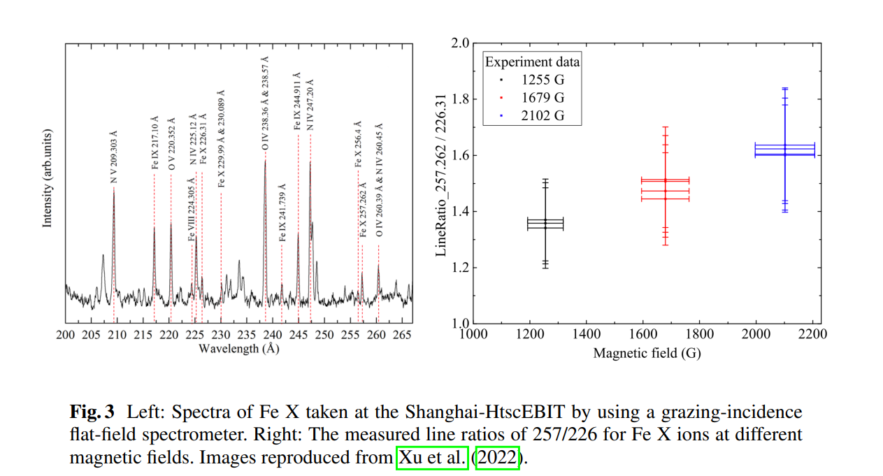

Slide 55
Easiest is to let the collision rate = the MIT rate and look what happens.
We can simulate spectral for different conditions and show that indeed the influence of the Fe X MIT can be seen in a fusion plasma.
Albeit a rather cold fusion plasma, as Fe X needs a plasma temperate of around 250 eV
This leads to the question, are there others MITs.
The answer is … we do not know yet

Slide 56
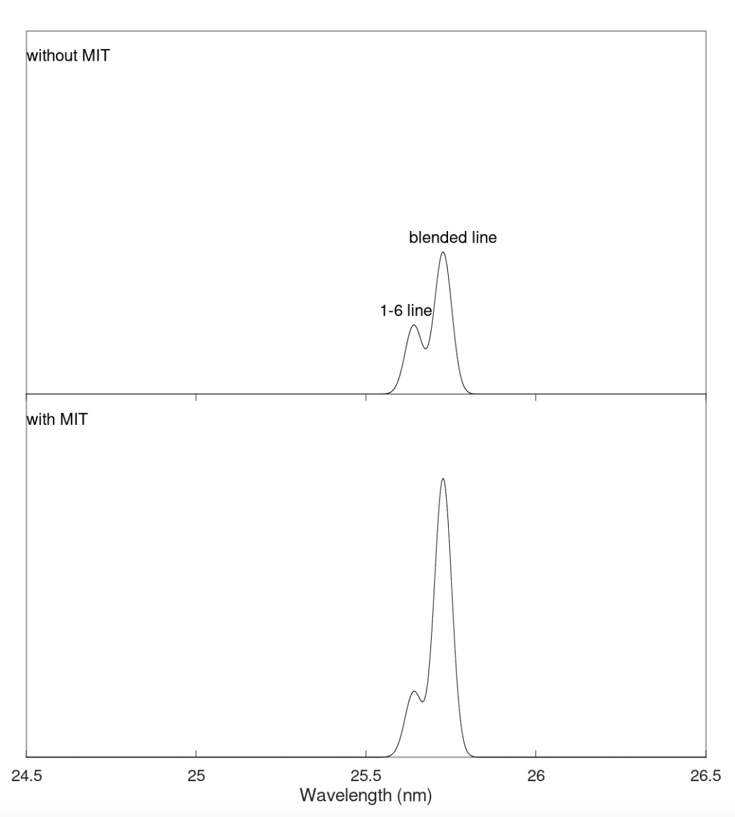
The influence of the MIT on the Fe X spectral region around 25.7 nm. The temperature and density for this simulation were 230 eV and 2x10¹² cm⁻³ respectively.

